Slide 1

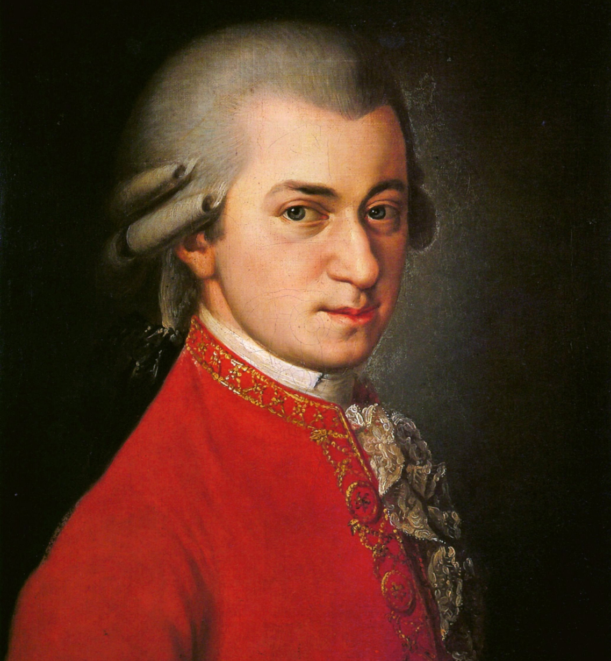
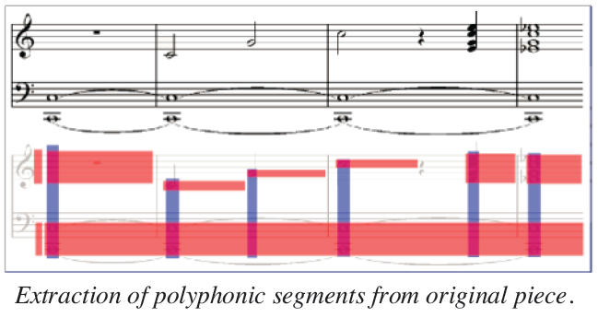

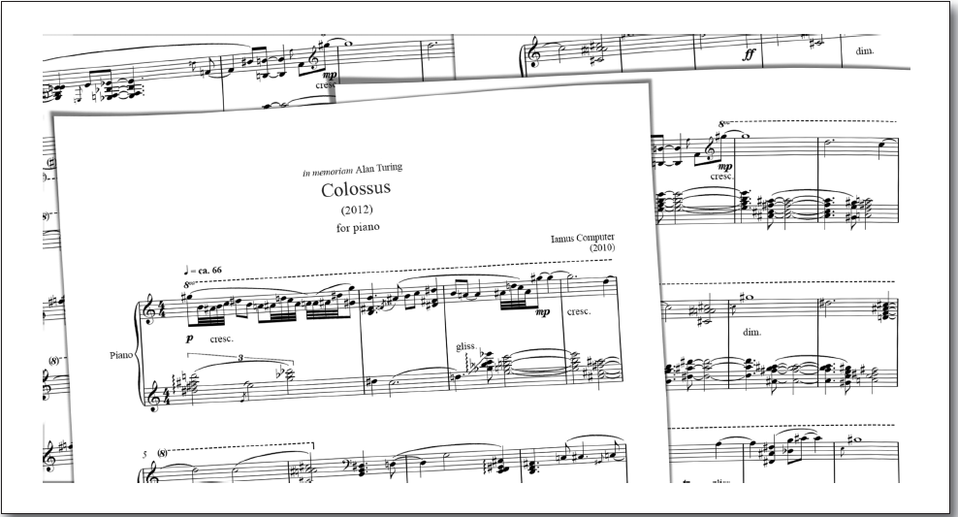
Artificial Intelligence and Music
Student: Mark Ian Bolante
Nipissing University
Department of Science and Technology
100 College Drive, North Bay Ontario, Canada, P1B 8L7
Professor: Dr. B. J. Schreyer
Nipissing University,
Department of Science and Technology
100 College Drive, North Bay Ontario, Canada, P1B 8L7;
bjs@nipissingu.ca
Introduction
Recognizing Musical Notation Using Artificial Neural Networks
Music is comprised of elements and refined sequences of them that affects listeners’ perception and sensations. Algorithmic composition is the technique of using algorithms to create music. With the help of artificial intelligence (AI) and the exponential growth of technology, more sophisticated methods of algorithmic compositions have been researched and developed.
Another application of AI in Music is recognizing musical notation using artificial neural networks (ANN). ANNs are an approach where software is used to mimic biological neural networks similar to animals and humans. Optical character recognition (OCR) is a method that converts handwritten or printed text into recognizable mechanical or electronic machine-encoded text. Combining these two approaches and using software such as PyBrain, OpenCV and MusicXML, musical notation recognition can be achieved. The following figures show examples of “training” the neural network to better recognize notes.
Composition Methods
Rotation
A composition consists of manipulating each aspect of music: harmony, melody, form , rhythm, and timbre. When computer music is made, it typically is the result of complex algorithm operating. Some common types of algorithms include:
Shearing
Mathematical models
Knowledge-based systems
Grammars
Evolutionary methods
Systems that learn
Hybrid systems.
“Salt and Pepper” Noise
Currently, the most popular methods are as follows:
1. Generative Music – Music which is created by a computer and appears to be constantly changing and different.
2. Evolutionary Music – Computer music that is created using an evolutionary algorithm (a subset of evolutionary computation that is based on mechanisms of biological evolution).
3. Computer-Aided Algorithmic Composition – Machine improvisation by recombination of different musical phrases.
Automatic Real-Time Music Generation for Games
Furthermore, AI can be used into automatic real-time music generation for games. Music plays a vital role in the enjoyment of video games. However, small-medium game studios find difficulty in financing original scores and soundtrack for their games. Implementing automatic real-time music generation system into the game not only gives the game studio an inexpensive solution, but also allows them to have more space in the game. This is achieved by using a music composition tool based on a variation of a Markov model. Each state is a set of notes that share a common starting position within a bar. A composition is broken down into these states, and the resulting Markov model stores the frequencies of notes and transitions within that composition as shown in the figure below.
Applications
Melomics
Melomics is a computational system that focuses on algorithmic composition and aims at the full automation of the composition process of professional music. The system is fully autonomous: once programmed, it composes music without human intervention. To achieve these results, instead of traditional AI techniques, an approach based on evolutionary algorithms and indirect encoding has been followed – evolutionary developmental biology (evo-devo). In evo-devo, evolutionary changes are interpreted as small mutations in the genome of organisms that modulate their developmental processes in complex and orchestrated ways, resulting in altered forms and novel features.
Each model could then be used to create polyphonic segments with output that follows the rhythmic boundaries, similar to the original piece. The result is a tool that generates original music by recombining portions of the original piece in new ways in real-time and switches between styles when signaled by the game.
Iamus is a computer cluster powered by Melomics’ technology and specializes in composing contemporary classical music. What makes Iamus strategy unique is that instead of learning by examples, it is taught to compose in a way that resembles how humans learn music composition rules. In essence, Iamus implements the evolution of complex musical structures, encoded into artificial genomes (resembling multi-cellular living organisms, which develop from a genome, and also evolve in time).
Conclusion
Artificial intelligence and music is a wide and active field of research today. It is a continuous developing field where more methods can be discovered or pre-existing ones further progressed with the advancement of technology. The information presented on this poster are just a few examples and applications of AI and music.
Side View of Iamus
References
[1] Attwenger, Pascal. Recognizing Musical Notation Using Artificial Neural Networks. Diss. University of Vienna, 2015.
[2] Engels, Steve, Tiffany Tong, and Fabian Chan. "Automatic Real-Time Music Generation for Games." Eleventh Artificial Intelligence and Interactive Digital Entertainment Conference. 2015.
[3] Latkina, Sofya. "Two-step Harmonious Melody Generator.“ 2015.
[4] Quintana, Carlos Sánchez, et al. "Melomics: A case-study of AI in Spain."AI Magazine 34.3 (2013): 99-103.
Examples of Scores Generated by Iamus

