Slide 1
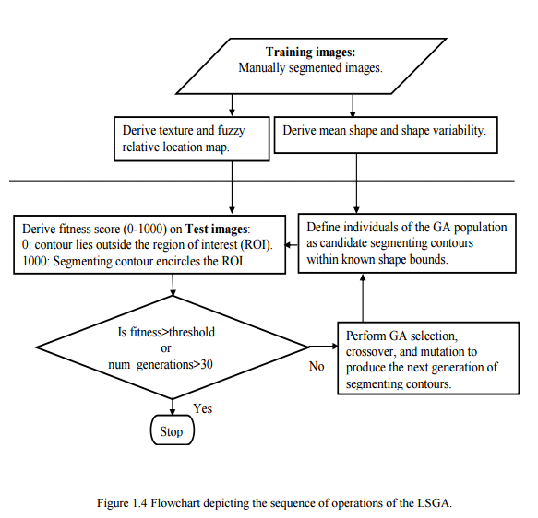
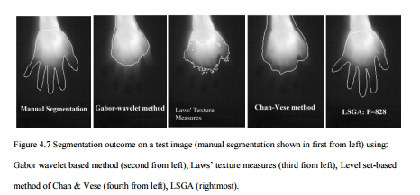
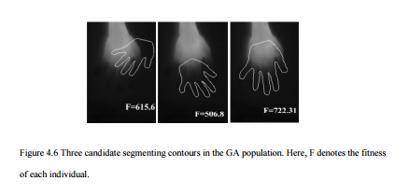
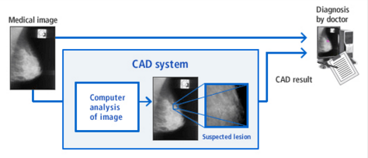
Medical Applications of Genetic Algorithms
Tsering Singhe, Student, Computer Science, Nipissing University, 100 College Drive, North Bay Ontario, Canada, P1B 8L7; tsinghe426@nipissingu.ca
Advisor: Dr.B.J.Schreyer, Computer Science and Math Department, Nipissing University, 100 College Drive, North Bay Ontario, Canada, P1B 8L7; bjs@nipissingu.ca
Brief overview of Genetic Algorithm (GA)
Genetic algorithms was developed by John Holland during the late 1950’s and early
1960’s. Inspired by the law of genetics, GA aims to mimic natural adaptation to find an
optimal solution.
As research in this field increased, genetic algorithms migrated into the commercial
sector, their rise fueled by the exponential growth of computing power and the
development of the Internet.
Evolutionary computation is a thriving field, and genetic algorithms are solving problems
of everyday interest in areas of study as diverse as stock market prediction and portfolio
planning, aerospace engineering, microchip design, biochemistry and much more.
One area of interest is the medical field. GA is applied in a variety of medical disciplines
such as Radiology, Cardiology, Endocrinology, oncology, pediatrics, surgery, neurology
and many more.
Medical image segmentation GA
The LSGA, Level Set-Based Genetic Algorithm shown here, was able to segment the images of hands by combining shape and texture. The result is very close to manual segmentation.
GA in the medical field
A GA that is used as a medical tool must have a high sensitivity and specificity to be considered a good algorithm.
Sensitivity is the measure of the proportion of positives that are correctly identified. In other words, if the person has a disease how often will the test detect it (be positive). So a GA with high sensitivity is more accurate when it eliminates the possibility of disease or abnormality.
Specificity is the measure of proportion of negatives that are correctly identified. In other words, if the person does not have the disease, how often will the test be negative. That means that a GA with high specificity is more accurate when it confirms the possibility of disease or abnormality.
GA in Radiology
Images need to be analyzed and interpreted by radiologists who need to be fast and accurate in their diagnosis. Computer-aided detection (CAD) and diagnosis can greatly assist radiologists in this endeavour. One particular application is in analyzing imagery from mammograms and in one study it allowed detection of suspicious areas with 95% sensitivity.
GA in Endocrinology
In patients with type 1 diabetes, hypoglycemia is a common and serious complication that can lead to comas. GA was combined with ANNs and Levenberg-Marquardt training techniques by Nguyen et al to detect hypoglycemia based on EEG signals. This system was able to detect hypoglycemia with 75% sensitivity and 60% specificity.
GA in Oncology
GA is often used in diagnosing different cancers. These techniques can be non-invasive and be done in a shorter amount of time than traditional diagnostic techniques. One such technique was developed to differentiate abnormal cervix to normal ones. This technique which used a GA-partial least square-discriminant analysis system had 72% sensitivity and 90% specificity in it’s diagnosis'.
Conclusion
GA has a broad range of applications, especially in the medical field that can greatly improve the accuracy and be faster than traditional methods. The GA must have high sensitivity and specificity to be useful in medical diagnostics. If the GA has too many false positives then patients would suffer from costly and invasive follow up tests and waste the time of the medical staff.
References
[1] Ghaheri, A., Shoar, S., Naderan, M., & Hoseini, S. (2015, November 30). The Applications of Genetic Algorithms in Medicine. Retrieved January 9, 2016, from http://www.ncbi.nlm.nih.gov/pmc/articles/PMC4678452/
[2] Sumathi, S., & Surekha, P. (2010). Computational intelligence paradigms theory and applications using MATLAB. Boca Raton: CRC Press.
[3] Ghosh, Payel.( 2010). Medical Image Segmentation Using a Genetic Algorithm (Doctoral dissertation). Retrieved from PDXScholar.

