Slide 1
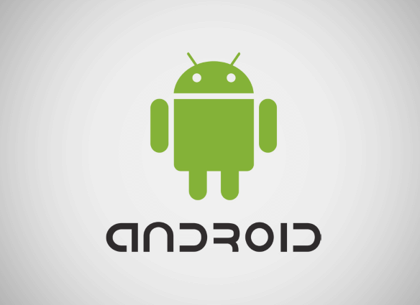
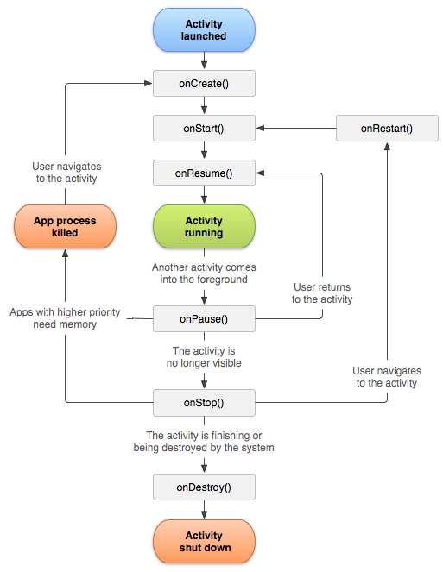
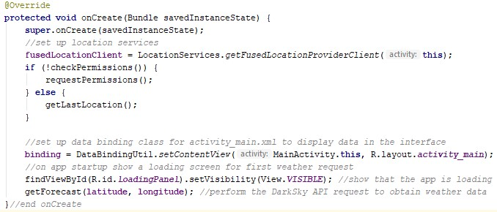
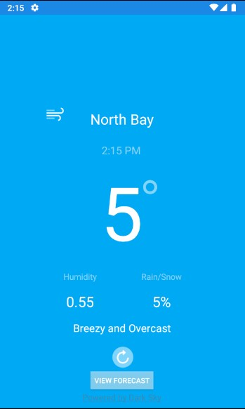
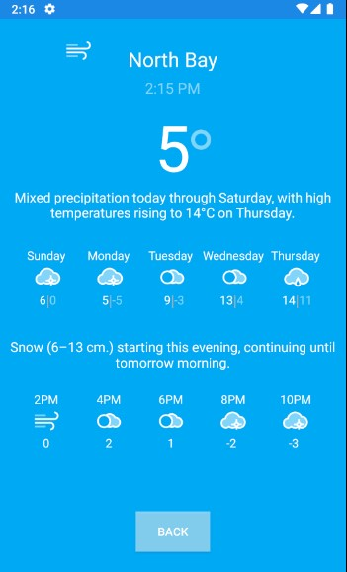
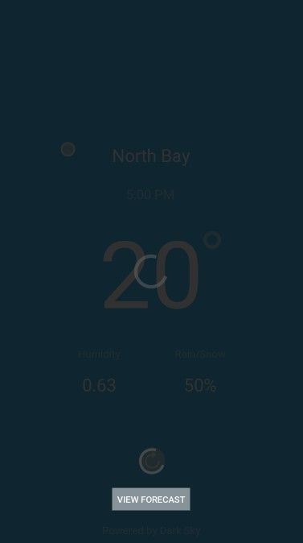
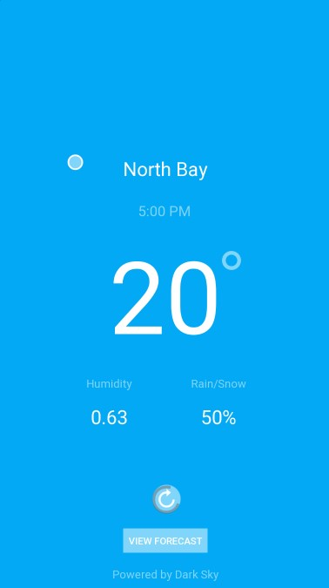
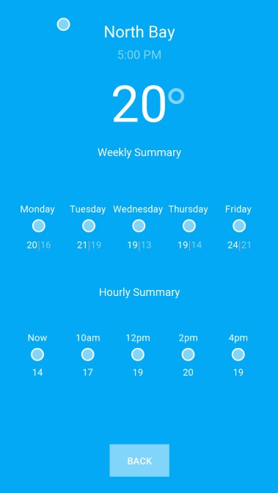
Android App Development
Student: Dillon MacGregor
Nipissing University
Department of Science and Technology
100 College Drive, North Bay Ontario, Canada, P1B 8L7
Professor: Dr. B. J. Schreyer
Nipissing University,
Department of Science and Technology
100 College Drive, North Bay Ontario, Canada, P1B 8L7;
bjs@nipissingu.ca
Introduction
The activity classes each have lifecycle periods. Figure 2, obtained from the official Android developer documentation illustrates all the states of an activity. The first state is the onCreate state where most of the work is done. The onCreate method for MainActivity is shown in Figure 3 below. Figure 3 shows some main functions called to initialize location services to get the user’s current location, connect to the interface to display the dynamic data, and finally send a request to the Dark Sky RESTful API to retrieve a response back containing all the required weather data. Once the data has been obtained POJOs are used to store and pass the data to the interface for display. All that is left is to implement to user interface with Android Studio and use Android’s data binding library to directly access POJO data within the XML files for each interface.
The purpose of this project is to provide a simple introduction to android app development using Android Studio by creating a straightforward but realistic app. The app created is a weather app named “Stormy” that uses a number of APIs including Dark Sky, OkHttp, and Google’s location services, and to dynamically determine current weather conditions for user locations.
App Development Overview
Design
The first stage of app development is the design stage. During this stage it is important to define all the technologies, specifications, and interfaces.
Technologies
API – Application Programming Interface
API’s provide developers with a number of powerful tools to perform complex tasks such as retrieving a list of current weather data for any location in the world. The interface of the API allows one to use third party SDKs or systems without needing to know the underlying details.
RESTful (Representational State Transfer) APIs such as DarkSky are generally web APIs where the interface is satisfied using an “identifier”. The DarkSky “identifier” is a URL in the form: https://api.darksky.net/forecast/[apikey]/[latitude],[longitude]
IDE – Integrated Development Environment
IDEs are software applications that provide multiple tools for software development. In this project Android Studio is used as the IDE.
SDK – Software Development Kit
SDKs contain all the pieces required for a software system, for Android Studio the Java Development Kit (JDK) is used. Additionally, an API is part of an SDK, that is, an API is the interface to an SDK where all the work is done.
Specifications
• Use the Model View Controller (MVC) design pattern to implement the app
Get weather data through the Dark Sky RESTful API using the OkHttp API to send web requests
• Acquire user’s location dynamically with Google play’s location service API
• The app must have two interfaces, one for a quick summary, and one that contains forecast weather data
Interfaces
• Interface design is generally done by creating interface mockups to guide the development process.
Figure 2: Android Activity Lifecycle
Figure 3: MainActivity OnCreate method.
Results
After implementing the backend, interface, and performing some testing the final results are shown below in Figure 4. All of the code and additional details are provided in the resources link below.
Conclusion
Figure 4: Final Results
Overall, knowing how to develop apps or at least how they are created is a useful skill. After all, most people interact with apps everyday. The app presented is a very basic but practical app. Weather apps are a great introduction to Android app development since they require a wide variety of fundamental techniques such as interface development, display of dynamic data, and use of common APIs such as RESTful APIs, internet connectivity APIs, and location service APIs. There are a number of improvements that can be made to this app. Feel free to get the source code from the resource link below and experiment with the app!
Figure 1: Interface Mockups
Implementation
In Android Studio apps are created using Java for app functionality and XML for the interface. In terms of the MVC design pattern this app has three classes that make up the model, two XML files that implement the view, and three more classes that function as the controller. The three classes for the model are plain old Java objects (POJOs) that hold the data retrieved from the Dark Sky API. The three other classes acting as the controller contain two separate activities and an error message handler, i.e, MainActivity, ForecastActivity, and AlertDialogFragment. The view is comprised of the interfaces for each activity class, i.e., activity_main.xml and activity_forecast.xml.
Resources
The completed app and all of the resources can be found in the following Github repository: https://github.com/dljm/WeatherApp.git

