Slide 1
Evolutionary Computation
Algorithms formed on the basis of biological life in the natural world
Adapted from Computational Intelligence Paradigms by S. Sumathi and Surekha p., Chapter 11

Slide 2
Introduction 1
Strongly based on the principles of natural evolution
Within the search space of an optimization problem, a population of individuals is initialized, a fitness function is used to evaluate the goodness of individuals
A selection operator gives evolutionary pressure so only the most fit individuals survive into the next generation

Slide 3
Introduction 2
An iterative process, like growth or development in a population
Optimal Solution is obtained using parallel processing among the population
Selection tends to eliminate individuals that demonstrate inappropriate behaviour, survivors reproduce
Random mutations cause novel behavioural characteristics
Over successive generations, increasingly appropriate behaviour accumulates

Slide 4
Introduction 3
Evolutionary computation can be modelled algorithmically
Basic overview of an evolutionary model:
x[t+1] =s(v(x[t]))
t – time
x[t] – population at time t
v – random variation
s - selection

Slide 5
Evolutionary Computation
Mutation and recombination are common methods for generating variation
Methods differ in
The data structure representation of individuals
Variation producing mechanisms
Survival selection methods

Slide 6
Pseudo Code for an Evolutionary Computation Algorithm
Generate an initial population in a random manner
While no stopping condition do
Select parents based on fitness
Produce offspring with some variants of their
parents
Select a few individuals to die based on
fitness
End While

Slide 7
Contents
History
Biological and Artificial Evolution
Flow Diagram
Models of Evolutionary Computation
Evolutionary Algorithms
Evolutionary Programming
Evolutionary Strategies
Advantages and Disadvantages

Slide 8
History 1
In the 1950s and 1960s it was shown that evolutionary computation can be used for solving optimization problems
Basic idea was evolving candidate solutions to a given problem using operators inspired by evolution
The idea to use recombination in evolutionary simulations did not come from a single innovation, but were commonly applied in multiple independent lines of investigation in the fifties and sixties

Slide 9
History 2
The use of Darwinian principles for automated problem solving originated in the fifties
In the sixties, three interpretations were developed:
Evolutionary Programming by Lawrence J. Fogel
Genetic Algorithm by John Henry Holland
Evolution Strategies by by Ingo Rechenberg and Hans-Paul Schwefel
Development in these three areas until the nineties
Since the nineties , these techniques have been combined into evolutionary computing

Slide 10
Contents
History
Biological and Artificial Evolution
Flow Diagram
Models of Evolutionary Computation
Evolutionary Algorithms
Evolutionary Programming
Evolutionary Strategies
Advantages and Disadvantages

Slide 11
Biological and Artificial Evolution 1
The idea behind Evolutionary Computation lies under the principles of biological evolution
This section describes some of the terminology and expressions used in Evolutionary Computing
Much of the terminology is borrowed from biology

Slide 12
Biological and Artificial Evolution 2
Biological Expression | Evolutionary Computation Implication
Chromosome | String of Symbols
Population | Set of chromosomes
Deme | Local population of closely related chromosomes (a subset of the total population)
Gene | A feature, character or detector
Allele | Feature value
Locus | A position in a chromosome
Genotype | Structure
Phenotype | A set of parameters, an alternative solution or a decoded structure
Table 1

Slide 13
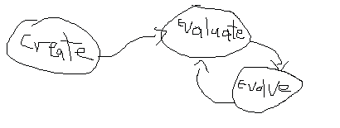
Biological and Artificial Evolution 3
The genes are the variables that will be optimized through the process of evolutionary computation
The process follows this sequence of operations:
Create an initial population, evaluate the population, then evolve the population

Slide 14
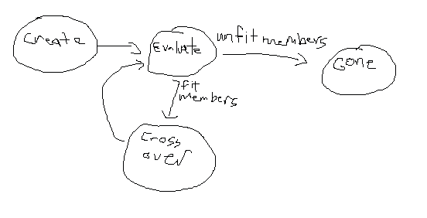
Biological and Artificial Evolution 4
At the end of each generation, the fittest chromosomes are retained and crossover with other fit members (like breeding)

Slide 15
Biological and Artificial Evolution 5
Population growth rate is a function of population size, so, left unchecked, a population will grow exponentially – Thomas Malthus
Crunch Time- since there are finite resources in an environment, a population will reach a point where organisms will have to compete for resources and more young will be produced than the environment can support – Charles Darwin

Slide 16
Biological and Artificial Evolution 6
Since more individuals are born than can be supported, there is a constant struggle for existence, thus any being that varies however slightly in a way that benefits itself will have a better chance of survival, and will be naturally selected (Evolution by natural selection)
3 Essential Ingredients of an Evolutionary Process:
Selection - environment must favour certain traits
Variation - individuals different from their ancestors must arise consistently
Heritability - children must inherit traits from their parents

Slide 17
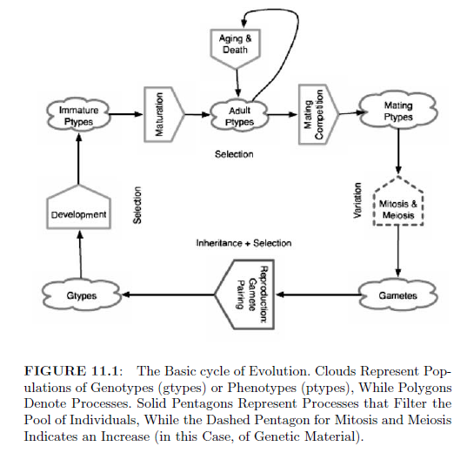
Biological and Artificial Evolution 7
Selection pressure present – solid lined pentagon

Slide 18
Contents
History
Biological and Artificial Evolution
Flow Diagram
Models of Evolutionary Computation
Evolutionary Algorithms
Evolutionary Programming
Evolutionary Strategies
Advantages and Disadvantages

Slide 19
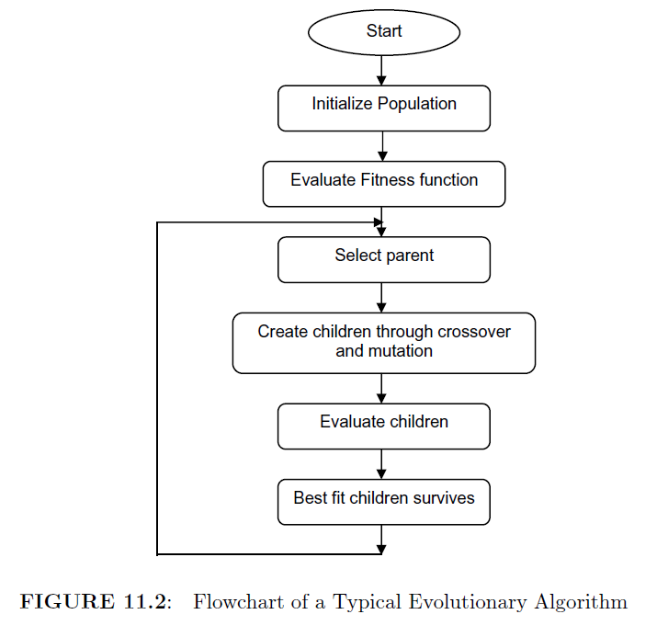
Flow Diagram 1

Slide 20
Flow Diagram 2
The population size generally stays constant
The evaluation process may be a simple fitness function, or as complicated as an elaborate simulation
Parent selection decides who will become parents and how many children they'll have
Children created by recombination and mutation, then evaluated

Slide 21
Contents
History
Biological and Artificial Evolution
Flow Diagram
Models of Evolutionary Computation
Evolutionary Algorithms
Evolutionary Programming
Evolutionary Strategies
Advantages and Disadvantages

Slide 22
Models of Evolutionary Computation 1
Paradigms:
Genetic Algorithms (GA)
J.H. Holland
Genetic Programming (GP)
de Garis and John Koza
Evolutionary Programming (EP)
L.J. Fogel, A.J. Owens, M.J. Walsh
Evolutionary Strategies (ES)
I. Rechenberg and H.P. Schwefel

Slide 23
Models of Evolutionary Computation 2
Genetic Algorithms 1
A basic model of machine learning, it draws its behaviour from mechanisms of evolution
Create an individual from a population of individuals represented by chromosomes
Used mostly for optimization
One common example – travelling salesman problem: the best shortest route has to be determined by optimizing the path

Slide 24
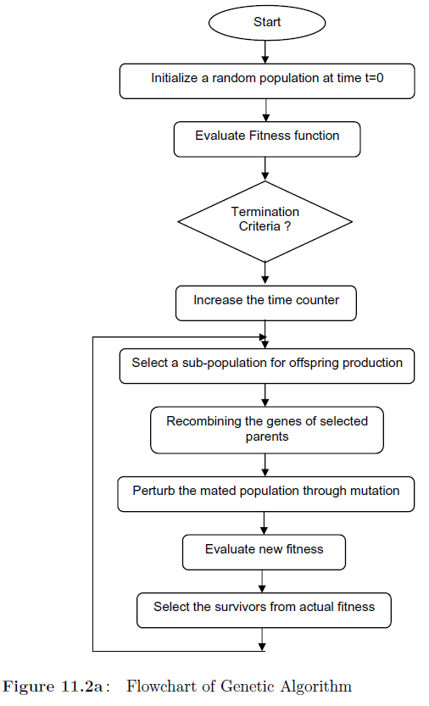
Models of Evolutionary Computation 3
Genetic Algorithms 2
Arrays of bits (or chars) represent chromosomes.
Simple bit manipulation operations used for crossover, multiplication
First generation is randomly generated
Every iteration, the old population is rejected, iteration continues with new population

Slide 25
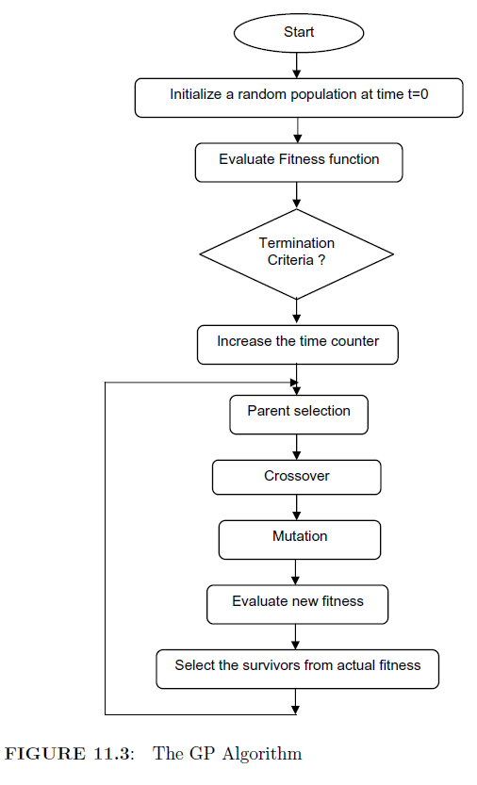
Models of Evolutionary Computation 4
Genetic Programming 1
Developed to allow automatic programming and program induction
A specialized version of the genetic algorithm
Can't distinguish between search space and representation space

Slide 26
Models of Evolutionary Computation 5
Genetic Programming 2
Genetic programs represented in tree or linear form
Main operator for GP is crossover, interchanges subtrees of parent trees
Mutation operator picks random subtree and replaces it with randomly generated subtree
Programs represented as parse trees instead of lines of code
Works naturally in Lisp

Slide 27
Models of Evolutionary Computation 6
Evolutionary Programming 1
A stochastic optimization strategy
Similar to genetic algorithms, but with emphasis on behavioural linkage between parents and their offspring
Similar to both GA and ES, efficient way to solve optimization problems

Slide 28
Models of Evolutionary Computation 7
Evolutionary Programming 2
Basic method involves 3 steps:
Step 1:Randomly choose initial population of trial solutions
Step 2: Every produced solution is copied into a new population, these offspring are then mutated according to a distribution of mutation types
Step 3: Every offspring is evaluated by computing its fitness function. Stochastic “tournament” selection applied, to determine solutions to be held back.
No constraint on population size to be held constant
Multiple offspring can be produced per parent
Normally no crossover operator

Slide 29
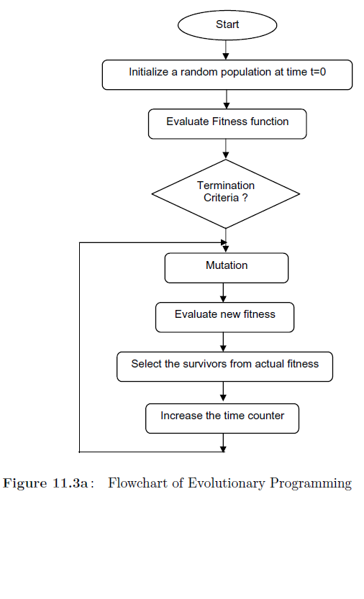
Models of Evolutionary Computation 8
Evolutionary Programming 3

Slide 30
Models of Evolutionary Computation 9
Evolutionary Strategies 1
Independently developed with operators such as selection and mutation and population size 1
Crossover and larger populations brought in later
Typically use real-valued vector representations
Devised to solve technical optimization problems

Slide 31
Models of Evolutionary Computation 10
Evolutionary Strategies 2
Two membered ES:
One parent generates one offspring per generation through normally distributed mutation
Multi-membered ES:
(m+l) (plus strategy) and (m, l) (comma strategy)
In plus strategy, parental generation is considered during selection
In comma strategy, only offspring undergoes selection, parents die off
m – population size, l-number of offspring generated per generation

Slide 32
Models of Evolutionary Computation 11
Evolutionary Strategies 3
Algorithm:
(define (Evolution-strategy population)
(if (terminate? population)
population
(evolution-strategy
(select
(cond (plus-strategy?
(union (mutate
(recombine population))
population))
(comma-strategy?
(mutate
(recombine population))))))))

Slide 33
Models of Evolutionary Computation 12
Evolutionary Strategies 4
Every individual in an ES' population consists of the following genotype:
Object Variables:
Real valued x(i) variables should be evolved through crossover and mutation so that the objective function reaches its global optimum
Strategy Variables:
Real valued s(i) variables/mean step sizes determine the mutatability of the x(i)
Learning takes place on 2 levels: genotypic (object and strategy variable) level and phenotypic (fitness) level
For fast convergence, ratio or m to l should be fairly low, around (15, 100) to find an optimal solution

Slide 34
Models of Evolutionary Computation 13
Evolutionary Strategies 5
Agents that greatly influence self-adaption within ESs:
Randomness
Mutation can't be completely random or the child would be independent of its parents
Population Size
A population must be sufficiently large. Rather than allowing only the current best solutions to reproduce, individuals that are good should also be allowed
Cooperation
Individuals should recombine knowledge with others, knowledge won't accumulate in best individual only
Deterioration
In nature, a restrained lifespan can prevent a species from freezing genetically

Slide 35
Contents
History
Biological and Artificial Evolution
Flow Diagram
Models of Evolutionary Computation
Evolutionary Algorithms
Evolutionary Programming
Evolutionary Strategies
Advantages and Disadvantages

Slide 36
Evolutionary Algorithms 1
Stochastic search and optimization heuristics derived from classic evolution theory
Basic Idea: If only individuals of a population that meet a certain selection criteria reproduce,and the other individuals die, then the population will converge to the individuals that best meet the selection criteria

Slide 37
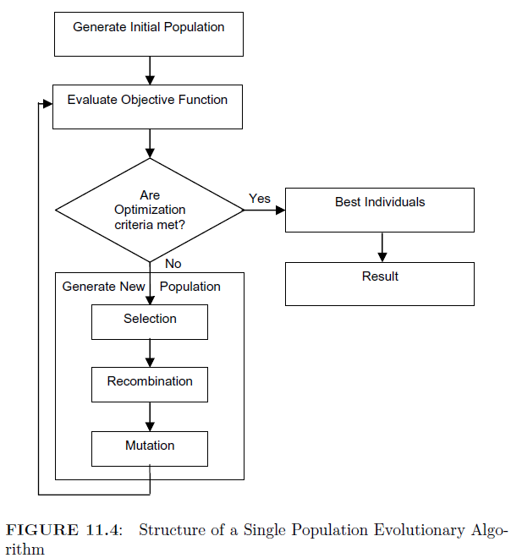
Evolutionary Algorithms 2
Single Population
Parents are recombined to produce offspring, offspring mutated with certain probability, then evaluated, then inserted into population, replacing their parents
Generations are produced until optimization criteria are met
Powerful, performs well
However, better results can usually be obtained by using multiple subpopulations.

Slide 38
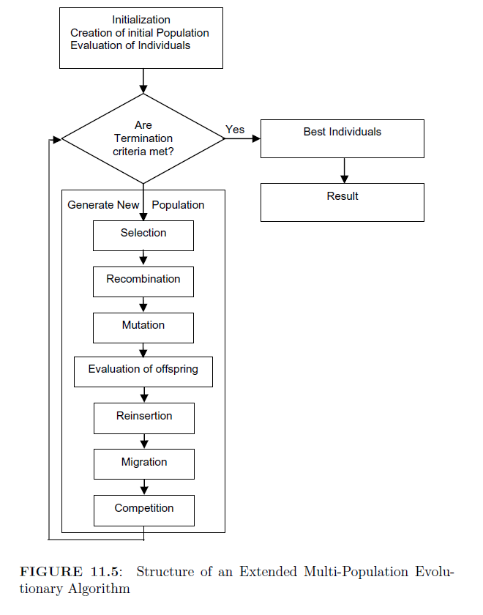
Evolutionary Algorithms 3
Multi-Population
Every subpopulation evolves independently for a few generations, then one or more individuals are exchanged between subpopulations.
More similar to nature

Slide 39
Evolutionary Algorithms 4
Evolutionary algorithms includes the domains of genetic algorithms, evolution strategies, evolutionary programming, and genetic programming
Parameters, procedures, and operators that define a particular EA:
Representation
Fitness Function
Population
Parent Selection Mechanism
Variation Operators, recombination and mutation
Reproduction Operator
Also, initialization procedure and termination condition

Slide 40
Evolutionary Algorithms 5
Solution Representation
Method of representing solutions/individuals
Most common- linear binary representations
Array of bits
Sections are well coordinated due to fixed size
Crossover operations are easy
Common genetic representations:
Binary array, genetic tree, parse tree, binary tree, natural language

Slide 41
Evolutionary Algorithms 6
Fitness Function
Special type of objective function, evaluates the optimality of a solution
Not only indicates how good the solution is, also should correspond to how close the chromosome is to optimal
Inserts a criterion for selection of chromosomes

Slide 42
Evolutionary Algorithms 7
Initialization of Population Size 1
Two effects to be considered: Initial population size and procedure to initialize population
Size has to increase exponentially with the complexity of the problem in order to generate best solutions
Large populations excessively costly
Acceptable results can be obtained with much smaller populations

Slide 43
Evolutionary Algorithms 8
Initialization of Population Size 2
Two methods
Heuristic initialization
Searches a small part of the solution space and never finds global optimal solutions because of lack of diversity in search space
Random initialization
This is used so global optimal solutions can be found

Slide 44
Evolutionary Algorithms 9
Selection Mechanisms 1
Natural selection is the mechanism by which evolution may occur in a population
Parents are selected according to fitness with one of these algorithms:
Roulette wheel selection
Stochastic universal sampling
Local selection
Truncation selection
Tournament selection

Slide 45
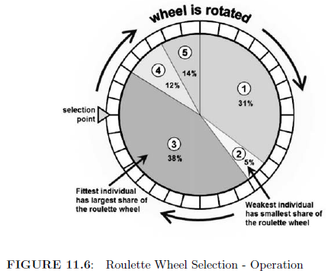
Evolutionary Algorithms10
Selections Mechanisms 2: Roulette Wheel Selection
Stochastically select from one generation to create the basis of the next generation
Fittest individuals have greater chance of survival
Number of times roulette wheel is spun is equal to the size of the population

Slide 46
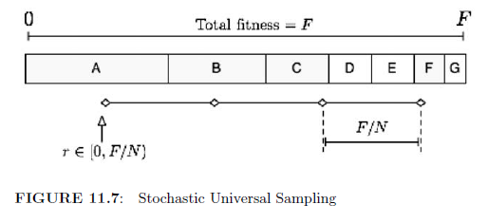
Evolutionary Algorithms 11
Selections Mechanisms 3: Stochastic Universal Sampling
Single phase sampling algorithm with minimum spread and no bias
N equally spaced pointers rather than one
Roulette wheel can be implemented as O(NlogN), this can be implemented as O(N)

Slide 47
Evolutionary Algorithms 12
Selections Mechanisms 4: Local Selection
A selection scheme that minimizes interactions among individuals
Leads to a more realistic reproduction scheme in an evolutionary model
Every solution is a candidate solution
Individuals compete for resources
No specific times when individuals reproduce or die, it all happens naturally

Slide 48
Evolutionary Algorithms 13
Selections Mechanisms 5: Truncation Selection
An individual's quantitative expression of a phenotype is more than or less than a “truncation point”
Ranks all individuals in terms of fitness, and selects the best ones as parents
Most commonly used in evolution strategies

Slide 49
Evolutionary Algorithms 14
Selections Mechanisms 6: Tournament Selection
A set of individuals are chosen in a random manner and the best one of them is chosen for reproduction
Usually 2 individuals per set
The best of every random pair of individuals is selected, so the population average fitness increase from one generation to the next is half the mean value of the difference between 2 randomly sampled individuals

Slide 50
Evolutionary Algorithms 15
Crossover Technique 1
Crossover (aka recombination) combines information from two parents into one or two offspring genotypes
Types of recombination
Discrete recombination
Real valued recombination
Binary valued recombination
Other
Arithmetic crossover
Heuristic crossover

Slide 51
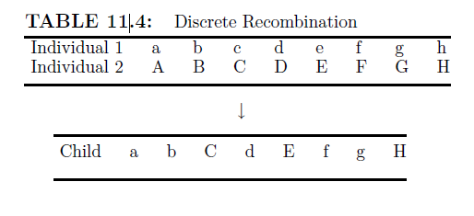
Evolutionary Algorithms 16
Crossover Technique 2
Discrete Recombination
Example: 2 individuals with 8 variables each (parents) combined to make child
Can be used with any kind of variables (binary, integer, real, symbols)

Slide 52
Evolutionary Algorithms 17
Crossover Technique 3
Real valued recombination
Child's variables are average between both parents

Slide 53
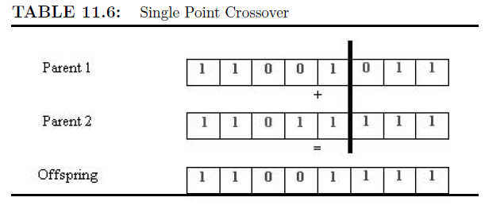
Evolutionary Algorithms 18
Crossover technique 4
Binary valued recombination (crossover)
For individuals with binary variables
Select 2 parents
Select crossover point
Parents mutually swap information with respect to crossover point
Single point, two point, and multi point

Slide 54
Evolutionary Algorithms 19
Crossover Technique 5
Arithmetic Crossover
Linearly combines parents using equations:
Offspring1 = a*Parent1+(1-a)*Parent2
Offspring2 = (1-a)*Parent1+a*Parent2
a is a random weighting factor
Heuristic Crossover
Uses the fitness values of the 2 parents to determine direction of search
Offspring1 = BestParent+r*(BestParent-WorstParent)
Offspring2 = BestParent
r is a random number between 0 and 1

Slide 55
Evolutionary Algorithms 20
Mutation Operator 1
Mutation operators used to maintain genetic diversity between succeeding populations of chromosomes
An arbitrary bit in a sequence will be changed
Purpose in EAs is to allow the algorithm to avoid local minima by preventing the population from becoming too similar to each other, thus slowing evolution

Slide 56
Evolutionary Algorithms 21
Mutation Operator 2
Real Valued Mutation
Randomly created values are added to the variables with a low probability
Binary Mutation
Variable values of individuals flipped randomly

Slide 57
Evolutionary Algorithms 22
Mutation Operator 3
Other types of mutation:
Flip bit - applied to binary string, inverts the value of the chosen gene
Boundary – replaces the value of the chosen gene with upper or lower bound
Non-Uniform – decreases mutation probability over time such that amount of mutation is close to zero
Uniform – replaces the value of the chosen gene with a uniform random value between the upper and lower bounds

Slide 58
Evolutionary Algorithms 23
Reproduction Operator
Applied to select the individuals that possess high quality solutions and that are capable of transmitting the information to the next generation
Rank grouping:
Individuals in a given population are ranked on their expected value and fitness instead of absolute fitness (excluding absolute fitness prevents convergence problems)

Slide 59
Contents
History
Biological and Artificial Evolution
Flow Diagram
Models of Evolutionary Computation
Evolutionary Algorithms
Evolutionary Programming
Evolutionary Strategies
Advantages and Disadvantages

Slide 60
Evolutionary Programming 1
Originally conceived by Lawrence J. Fogel in 1960
A stochastic optimization strategy similar to genetic algorithms, but emphasizes behavioural linkage between parents and their offspring instead of trying to emulate specific genetic operators observed in nature
Similar to evolutionary strategies, but developed independently
Like ES and GA, useful for optimization when techniques like gradient descent aren't possible

Slide 61
Evolutionary Programming 2
History
Artificial Intelligence through Simulated Evolution by Fogel, Owens, and Walsh, 1966 – landmark publication for EP applications
1992 – First Annual Conference on Evolutionary Programming

Slide 62
Evolutionary Programming 3
Procedure
Underlying assumption that a fitness landscape can be characterized in terms of variables, and there is an optimum solution in terms of those variables
3 steps (repeat until a threshold for iteration is exceeded or an adequate solution obtained)
Step 1: Randomly choose an initial population of trial solutions
Step 2: Every solution that is produced is copied into a new population. These offspring are then mutated
Step 3: Every offspring is evaluated by computing its fitness function. Usually a tournament selection is used. Normally no crossover in EP
No requirement that population size be constant

Slide 63
Evolutionary Programming 4
Differences between EPs and GAs
In GA, the problem solutions are encoded as a string of representative tokens, the genome. In EP, there is no constraint on the representation. Representation follows the problem
In EP, the severity of mutations is often reduced as the global optimum is approached, unlike in GA

Slide 64
Evolutionary Programming 5
Algorithm of EP
Step 1: Start with initial time t=0
Step 2: Initialize random population of individuals at t=0
Step 3: Evaluate fitness of all initial individuals
Step 4: Test for termination criterion (time, fitness, etc.) If a criterion is reached, go to step 8
Step 5: Perturb the whole population stochastically
Step 6: Evaluate its new fitness
Step 7: Select the survivors from actual fitness
Step 8: End

Slide 65
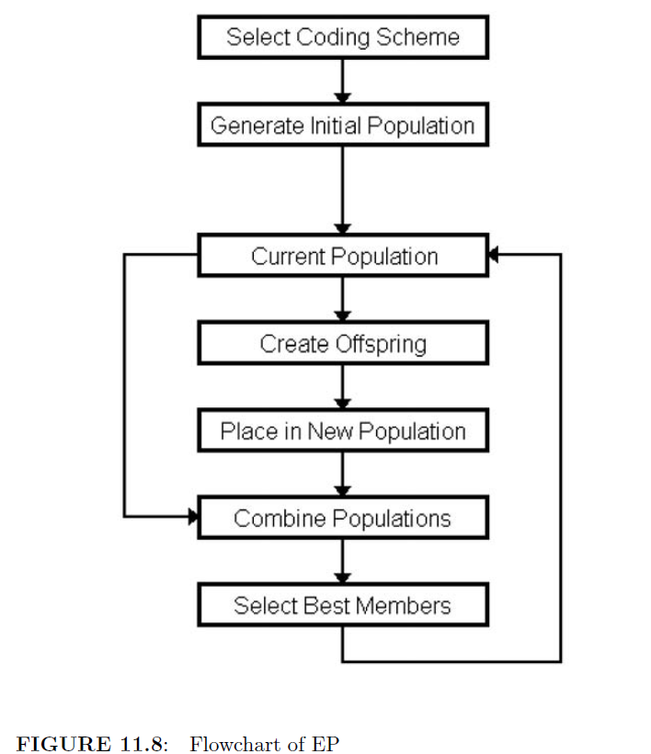
Evolutionary Programming 6
Flowchart

Slide 66
Evolutionary Programming 7
Select Coding Scheme
Some scheme needs to be used to store a solution. In a standard GA, a bit string is used. Bit stream does not work for some types of problems. Depending on application, coding scheme can be chosen by user
Example- Travelling Salesman Problem
A possible solution can be uniquely described by an array of integers of fixed length.
(A,B,C) could mean the salesman starts at city A, then travels to B and C before returning to A

Slide 67
Evolutionary Programming 8
Offspring Generation
Each member of the Current Population is used to generate an offspring
Each offspring placed in new population
Then the Current Population is merged with the new population
Selection procedure used to generate a Current Population for the next generation

Slide 68
Contents
History
Biological and Artificial Evolution
Flow Diagram
Models of Evolutionary Computation
Evolutionary Algorithms
Evolutionary Programming
Evolutionary Strategies
Advantages and Disadvantages

Slide 69
Evolutionary Strategies 1
Developed by Rechenberg and Schwefel at the Technical Universtiy of Berlin
Motivation has been, from the beginning, to solve engineering design problems
Representation used is a fixed-length real-valued vector. Each position in the vector corresponds to a feature of the individual. Features are behavioural rather than structural

Slide 70
Evolutionary Strategies 2
Important Features:
1. ESs use real-coding of design parameters since they model organic evolution at the level of individual's phenotypes
2. ESs depend on deterministic selection and mutation for their evolution
3.ESs use strategic parameters such as on-line self-adaptation of mutability parameters

Slide 71
Evolutionary Strategies 3
ESs differ from traditional optimization optimization algorithms in a few ways:
ESs search between populations, rather than between individuals
The objective function information is sufficient, derivatives not required
The transition rules used by ESs are probabilistic, not deterministic

Slide 72
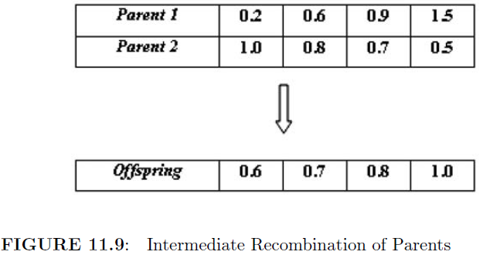
Evolutionary Strategies 4
Reproduction usually only by mutation
Gaussian mutation operator
Sometimes an intermediate recombination operator is used, where vectors of two parents are averaged together (less constrained)
Can easily use more than 2 parents to form a single offspring

Slide 73
Evolutionary Strategies 5
Solution Representation
n- dimensional real-valued vector is usually appropriate
Mutation
In GA mutation is usually a background operator, with crossover being the primary mechanism
In ES, though, mutation takes the central role
Mutation procedure:
1st, if they exist, standard deviations and rotation angles associated with individual are mutated
Then the vector of control variables (x) is mutated
x' = x+n where n is a vector of random numbers sampled from the n-dimensional normal distribution

Slide 74
Evolutionary Strategies 6
Recombination 1
A variety of recombination operators have been used
Discrete Recombination
Offspring inherits from two randomly selected parents
Global Discrete Recombination
Offspring inherits each component from different parents, every member has an equal chance of contributing

Slide 75
Evolutionary Strategies 7
Recombination 2
Intermediate Recombination
Offspring inherits components that are weighted averages of two randomly selected parents
Global Intermediate
Intermediate, but every component has different parents
ES performs best when discrete is used on control variables and intermediate on strategy parameters

Slide 76
Evolutionary Strategies 8
Population Assessment
ES does not use derivative information, just needs an objective function value for each member of each population
Evaluation of the problem functions is basically a “black box” operation as far as the ES is concerned
Infeasible solutions can be rejected (not selected as parents in the next generation)

Slide 77
Evolutionary Strategies 9
Convergence Criteria
Two tests used to terminate ES searches
One: the absolute difference in the objective function values of the best and worst members is less than a user specified limit
|f_w -f_b|<w
Two: the relative difference in the objective function values of the best and worst members is less than a user specified limit

Slide 78
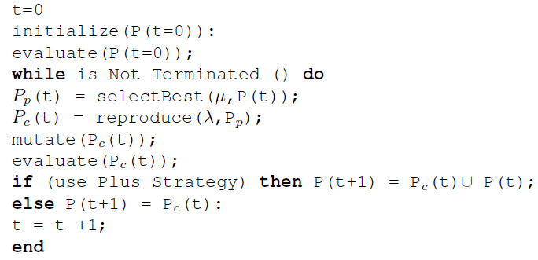
Evolutionary Strategies 10
Pseudocode

Slide 79
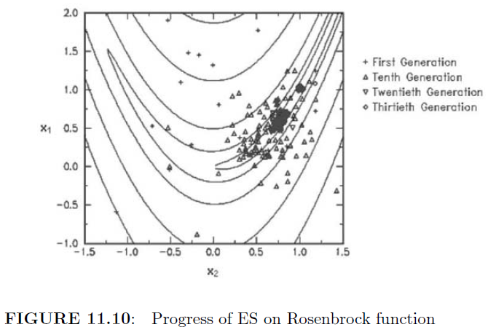
Evolutionary Strategies 11
Progress of an ES on the 2D Rosenbrock function, f=(1x_1)^2+100(x_2-x_1)^2
Converges to optimal solution (1,1)

Slide 80
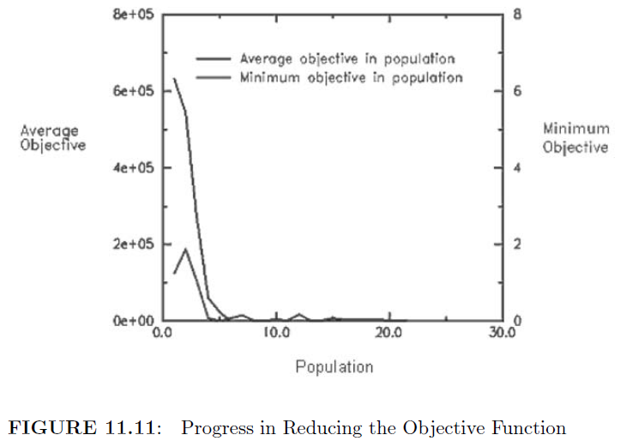
Evolutionary Strategies 12
Progress in reducing the objective function

Slide 81
Contents
History
Biological and Artificial Evolution
Flow Diagram
Models of Evolutionary Computation
Evolutionary Algorithms
Evolutionary Programming
Evolutionary Strategies
Advantages and Disadvantages

Slide 82
Advantages and Disadvantages 1
Advantages of Evolutionary Computation
Global optimization methods that scale well to higher dimensional problems
Robust with respect to noisy evaluation functions
Handling of evaluation functions which do not yield a sensible result in a given period is straightforward
Applicable to a wide variety of optimization problems
Works with functions with continuous, discrete, or mixed parameters
Easy to parallelize

Slide 83
Advantages and Disadvantages 2
Disadvantages of Evolutionary Computation
The best algorithms for solving some kind of problem will almost always utilize characteristics of that problem, so the best algorithms to solve specific class problems are usually not based on evolutionary computation
Computationally intensive
Impossible to guarantee a particular quality of solution, so not usually well suited to real-time applications
Can be difficult to choose an algorithm, and can be difficult to tune the parameters

Slide 84
END
Sumathi, S. ,., and P. ,. Surekha. "Chapter 11: Evolutionary Computation Paradigms." Computational Intelligence Paradigms: Theory and Applications Using MATLAB. Boca Raton, FL: CRC, 2010. N. pag. Print.

