Slide 1
Genetic Programming

Slide 2
Introduction
What is Genetic Programming?
History
Lisp
Genetic operations
Examples

Slide 3
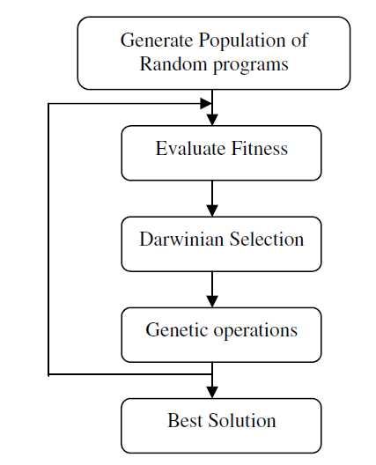
Genetic Programming
Algorithm determines values
Programming writes an entire solution program

Slide 4
History
1950 – 1970’s
Evolutionary algorithms
1980
Methodology introduced by Stephen F Smith
1981
Forsyth reports evolved programs
1985 and 1987
Nichael L Cramer and Jürgen Schmidhuber
“GP are procedural languages coordinated in tree-based structures and functioned by suitably defined GA-operators”

Slide 5
Lisp
List Processing
Contains two basic data structures
List and atom (A (1 2) D (4 (6 G)))
Functional programming language
(defun square (x)(* x x))
(defun hypotenuse (a b) (sqrt (+ (square a) (square b))))
Functions stores as data; very useful for GP

Slide 6
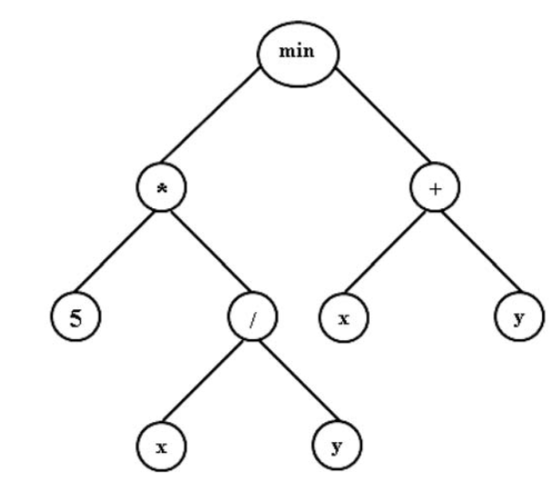
Representation
Storage
Parse trees
Syntax trees
Finite automata
grammars
Internal nodes are functions, leaves are terminals or arguments
Prefix notation

Slide 7
Genetic Operators

Slide 8
Initialization
Programs more difficult than values
How to initialize a random program?
Representation holds a key importance
Functions and terminals
Functions require arguments/terminals
A proper selection of terminals and functions is imperative to a solution
Grow, Full, Ramped-Half-and-Half

Slide 9
Grow
Defines an individual up to a specified depth
Starts at the root, recursively:
Randomly creates a function or a terminal
If it’s a function, then the process repeats on the children, which are the function’s arguments
If the maximum depth is reached, then a random terminal
This often produces only single terminal individuals, but are often bred out quickly

Slide 10
Full
Defines and individual exactly to a specified depth
Each node less than the depth is a random function
Any node at the depth is a random terminal
The number of nodes relies on the function’s arguments, so is not known
Only if the depth is 1 would a single terminal individual form

Slide 11
Ramped-half-and-half
Grow and Full together create diversity.
Half of the population is created through each
This gives a good size range of simple to full solutions

Slide 12
Fitness
The individual/program is executed for evaluation
The problem description often does not contain only one set of parameters
Many executions are required with different parameters to evaluate fitness level
Fitness is the average value of each execution
Every individual must contain the same amount of executions

Slide 13
Selection
Depending on the application, different selections can be appropriate
Fitness-proportionate
Greedy over-selection
Tournament

Slide 14
Fitness-proportionate
Almost the same as in Genetic Algorithms
Raw fitness restated as standardized fitness
Lower value implies better individual
standard = maximum – raw
Standardized then restated as adjusted
Higher value implies better
$$adjusted= \frac{1}{1+standard}$$
Useful for separation of individuals with standard fitness approaching zero

Slide 15
Fitness-proportionate
Adjusted fitness is then normalized
normal = adjusted / sum of adjusted
Probability of selection is calculated
probability = normal / sum of normal
This gives a probability value between 0 and 1
One implementation for probability
Order individuals best to worst by normalized fitness
Choose a random number between 0 and 1
Iterate over the list, keeping the sum until it is greater than the random number
Select that individual

Slide 16
Greedy over-selection
Uses normalized fitness values
Splits the population into 2 groups
Group 1 contains the top 20%; group 2 has the rest
Selection choosing a random group, then using FP selection
This biases towards the highest preformers

Slide 17
Tournament
Pairs of individuals are chosen at random and tested for a fitness winner
Winners are recursively tested for a fitness winner
Selection occurs by traversing each layer of winners until selection is complete
This guarantees that the best will be chosen, but not the second best

Slide 18
Crossover
Sub-tree swapping
Very simple when using a parse tree
A random sub-tree of each parent is chosen
The sub-trees are swapped, producing two new individuals/children
Even identical parents can have different offspring
Not possible with 1 or 2-point crossover

Slide 19
+
*
b
b
*
*
+
*
+
2
2
a
c
*
*
2
2
a
c
Parent 1
Parent 2
+
*
2
a
b
*
1
a
+
+
*
b
b
*
*
+
*
*
2
2
a
c
2
a
Child 2
Child 1
+
*
b
*
1
a
+
+
2
2
*
a
c

Slide 20
Twins
+
*
b
b
*
*
+
*
*
2
2
a
c
2
a
+
*
b
b
*
*
+
*
*
2
2
a
c
2
a
Parent 1
Parent 2
+
*
b
b
*
*
+
2
a
2
a
+
*
b
b
*
*
+
*
*
2
2
a
c
*
2
2
*
a
c
Child 1
Child 2

Slide 21
Mutation
Two types of mutation
Node
Functions replace functions, terminals replace terminals
Tree
An entire tree can replace a sub-tree

Slide 22
Elementary Steps
We have a problem, how do we solve it?
Set of terminals
What are the terminals?
Set of functions
What argument functions are required?
Fitness Measure
How do we measure the effectiveness of an application?
Parameters
Which parameter set would work best?
Termination Criterion
Where does it stop and how do we get the results?

Slide 23
Terminal Set
Contains all constants, variables, and zero-argument functions
π
Robot movement
Left, right, forward, backward
Variables of times of each movement

Slide 24
Function Set
Single- or multi-argument functions
Could be as simple as arithmetic functions
Functions could be user-created tailored for the problem
Can contain programmatic functions and branching
If-then-else, for loops, etc

Slide 25
Fitness Function
The fitness is the measure of how well the program preformed the task
Very important to be optimized
Will need to be ran for each generation for each individual

Slide 26
Parameters
Genetic Algorithms Parameters
Size of the program should be kept small
Too large of a program will be hard to understand
The maximum depth should be a small number

Slide 27
Termination
Often a set number of generations
Sometimes best individual after a specified time
Could possibly allow monitoring
Stopped at any time the user desires

Slide 28
