Slide 1
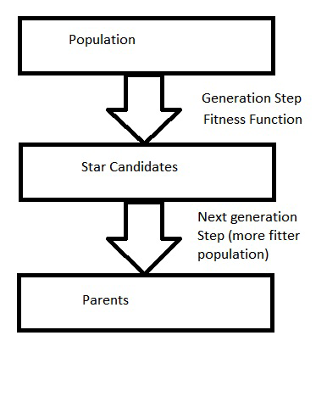
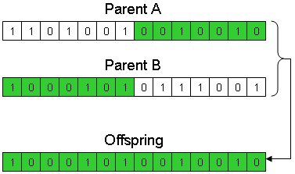
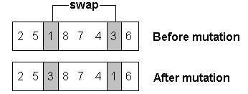
Schema Theorem in Genetic Algorithms
Parampreet Lobana, Student, Science and Technology- Robotics, Nipissing University, 100 College Drive, North Bay Ontario, Canada, P1B 8L7
Advisor: Dr.B.J.Schreyer, Computer Science and Math Department, Nipissing University, 100 College Drive, North Bay Ontario, Canada, P1B 8L7; bjs@nipissingu.ca
Introduction
Genetic Algorithms (GA) belong in the family of evolutionary algorithms. These algorithms were based on evolution of nature, such as mutation or selection. As viruses and bacteria undergo mutation and resistance, GA’s were developed to mimic these properties.
History Overview
The father of GA’s was John Holland. His vision was to determine exactly how adaption occurs in nature and then develop ways to mimic that adaptation which might become a part of a computer system .
Initially, GA’s were applied to broad range of subjects such as abstract mathematics, to engineering problems such as pipeline flow control or pattern recognition.
Due to the exponential growth of computing power and the development of internet, GA’s became a thriving field. Today, GA’s are solving problems such as portfolio planning, aerospace engineering, microchip design and much more.
Standard Algorithm
The standard algorithm for GA as follows:
1). An initial population is generated at random.
2). Every evolutionary step, known as a generation, the individuals in the current population are evaluated according to some criteria using the fitness function.
3). To create the next generation, the individuals selected according to their fitness become the parent solutions. The picture below shows the condensed version.
Operations
Crossover: It is a genetic operator used to vary chromosomes from one generation to the next. These solutions have a crossover probability rate ($p_{cross}$). This operator tends to enable the evolutionary process. The picture below shows an example of crossover process.
Mutation: It is also a genetic operator that is used to maintain diversity from one generation to the next. In mutation, the solutions may change entirely from the previous solution. It is carried by flipping bits at random with some probability ($p_{mut}$). The picture below shows an example of mutation process.
Hyperplanes, referring to geometry, is a subspace of the n dimension where n refers to the original dimension. For example, the hyperplane of a 3-D dimension a plane. A plane divides such a dimension (3-D in this example) into its subspace.
Schema Theorem
The Schema Theorem ties in all the methods described before into a mathematical equation.
The schema 10*0*1 describes the set of all strings of length 6 with 1s at position 1 and 6 and 0s at position 2 and 4. The “*” describes a wildcard position, this wildcard position could either be a 0 or 1.
The number of fixed positions in the schema is known as the order and it also has a defining length.
Defining length of a schema is measured between the first and the last bit with the values of either 1 or 0.
The schema contains 0, 1 or *. Going from left to right, $I_{x}$is the index for the last event of either a 1 or 0. $I_{y}$ is the index for the first event of either a 0 or 1. Thus, defining length can be noted as $I_{x}−$ $I_{y}$.
For example, consider the following schema: ****1**0**10**.
Looking for the last event ($I_{x}$), 0 is positioned at length 12, looking for the first event ($I_{y})$ , 1 is positioned at length 5. Therefore, the defining length is: 12 - 5 = 7.
Moreover, the defining length of schema representing a hyperplane (H) is denoted by $∆\left(H\right).$
The fitness function is also a mathematical function used to evaluate the problem environment.
The fitness of a schema is the average fitness of all strings. The fitness of a string is measured using the evolution function. The Schema Theorem states that short, low-order, schemas with above-average fitness levels increase exponentially in successive generations. It is expressed by the following equation:
$m(H,t)$is the number of strings belonging to schema$H$at generation $t$. $m\left(H,t+1\right)$ is the next generation.
$f\left(h\right)$ is the observed fitness of schema H and is the observed average fitness at generation t . The probability of disruption, p, is the probability that the crossover or mutation will destroy schema. It can be expressed as:
o(H), order (H), is the number of fixed positions, l is the length of the code, $p_{m}$ is the probability of mutation, $p_{c }$is the probability of crossover. $∆(H)=δ\left(H\right)$ is the defining length.
Order-1 hyperplanes are not affected by recombination , however, Order-2 and higher hyperplanes are affected by crossover. Moreover to consider $m(H,t+1)$, the effects of crossover must be taken into account as when crossover occurs, the losses from disruption will change the next generation.
Consider two schemas: *****111 and 1*****1*.
The order of schemas: $o(S_{1})$ = 3 and $o(S_{2})$ = 2.
The defining length of the schemas: $δ\left(S\right)=$ $I_{x}−$ $I_{y}$ = 8$−$6 = 2 and 7$−$1 = 6.
Assume $p_{m}$=0.001, the probability of survival for each schema can be found using: $p_{m}$(S) = ${(1−p_{m})}^{o(S)}$
$p_{m}$($S_{1})$ = ${(1−0.001)}^{3}$= 99.7% and $p_{m}(S_{2})$ = 99.8%.
Assume $p_{c }$= 0.85, the probability of survival can be found as: $p_{c }\left(S\right)≥\left(1−p_{c }\right)$ * ( $\frac{∆(S)}{m−1}$)
m is the length of the schema (8), not to be confused with defining length.
$p_{c }\left(S_{1}\right)= 76\% and p_{c }\left(S_{2}\right)=27\%$
Putting everything together, probability of disruption can be calculated.
p$\left(S_{1}\right)$= $\frac{3}{7}$ (0.76) + $3(0.997)$ = 0.03317% and p($S_{2})= \frac{2}{7} \left(0.27\right)+2\left(0.998\right)=$ 0.02073%
Using the fitness-proportionate function (for example) to evaluate the population.
Conclusion
In conclusion, this short introduction to schema theorem provides a basis to developing more complex fitness functions, considering the change to hyperplanes and the destruction of schemas. As the schemas are destroyed by crossover or mutation, there will be no advancement for the next generation.
Reference: Sumathi, S., & Surekha, P. (2010). Computational intelligence paradigms theory and applications using MATLAB (p. 547 to 570). Boca Raton: CRC Press.

