Slide 1
Hist 1106 Food: A North American History
Dr. James Murton

Slide 2
Introduction to Food: A North American History
Hist 1106 as an Introduction to Historical Studies
Food is So Basic and Central that it has Often Not Had a History, But it Should Have a History
Food is Something with a Complex History and Which, Done Well, Can be Good in Every Sense
Go Over the Course

Slide 3
Hist 1106 as an Introduction to Historical Studies

Slide 4
Queen’s Inn, 125 Brock ST, Kingston

Slide 5
II. Food is So Basic and Central that it has Often Not Had a History, But it Should Have a History

Slide 6
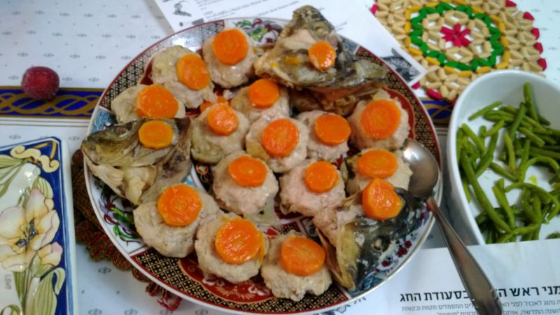
Gefilte Fish Topped with Carrots

Slide 7
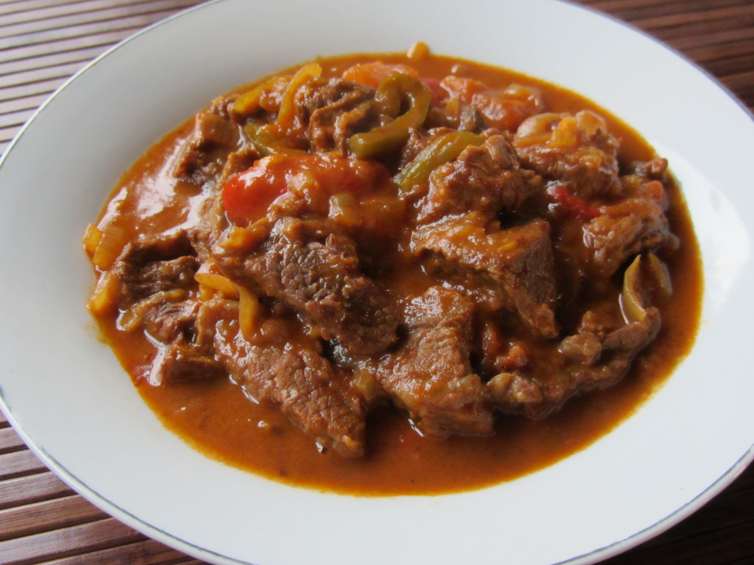
Hungarian Goulash

Slide 8
III. Food is Something with a Complex History and Which, Done Well, Can be Good in Every Sense

Slide 9
Foodways
Foodways: “ways of conceptualizing, evaluating, preparing and consuming foods characteristic of a particular society, cultural group or geographical area” (Dic Human Geog)
Creoles and creolization

Slide 10
Two Propositions
Food as something with a complex environmental, cultural, political history
And as something that, done properly, can be good in every sense, for the earth and for the people that produce and eat it

