Slide 1
Food as History
Introduction
Nutrition
Culinary Systems
Major Concepts

Slide 2
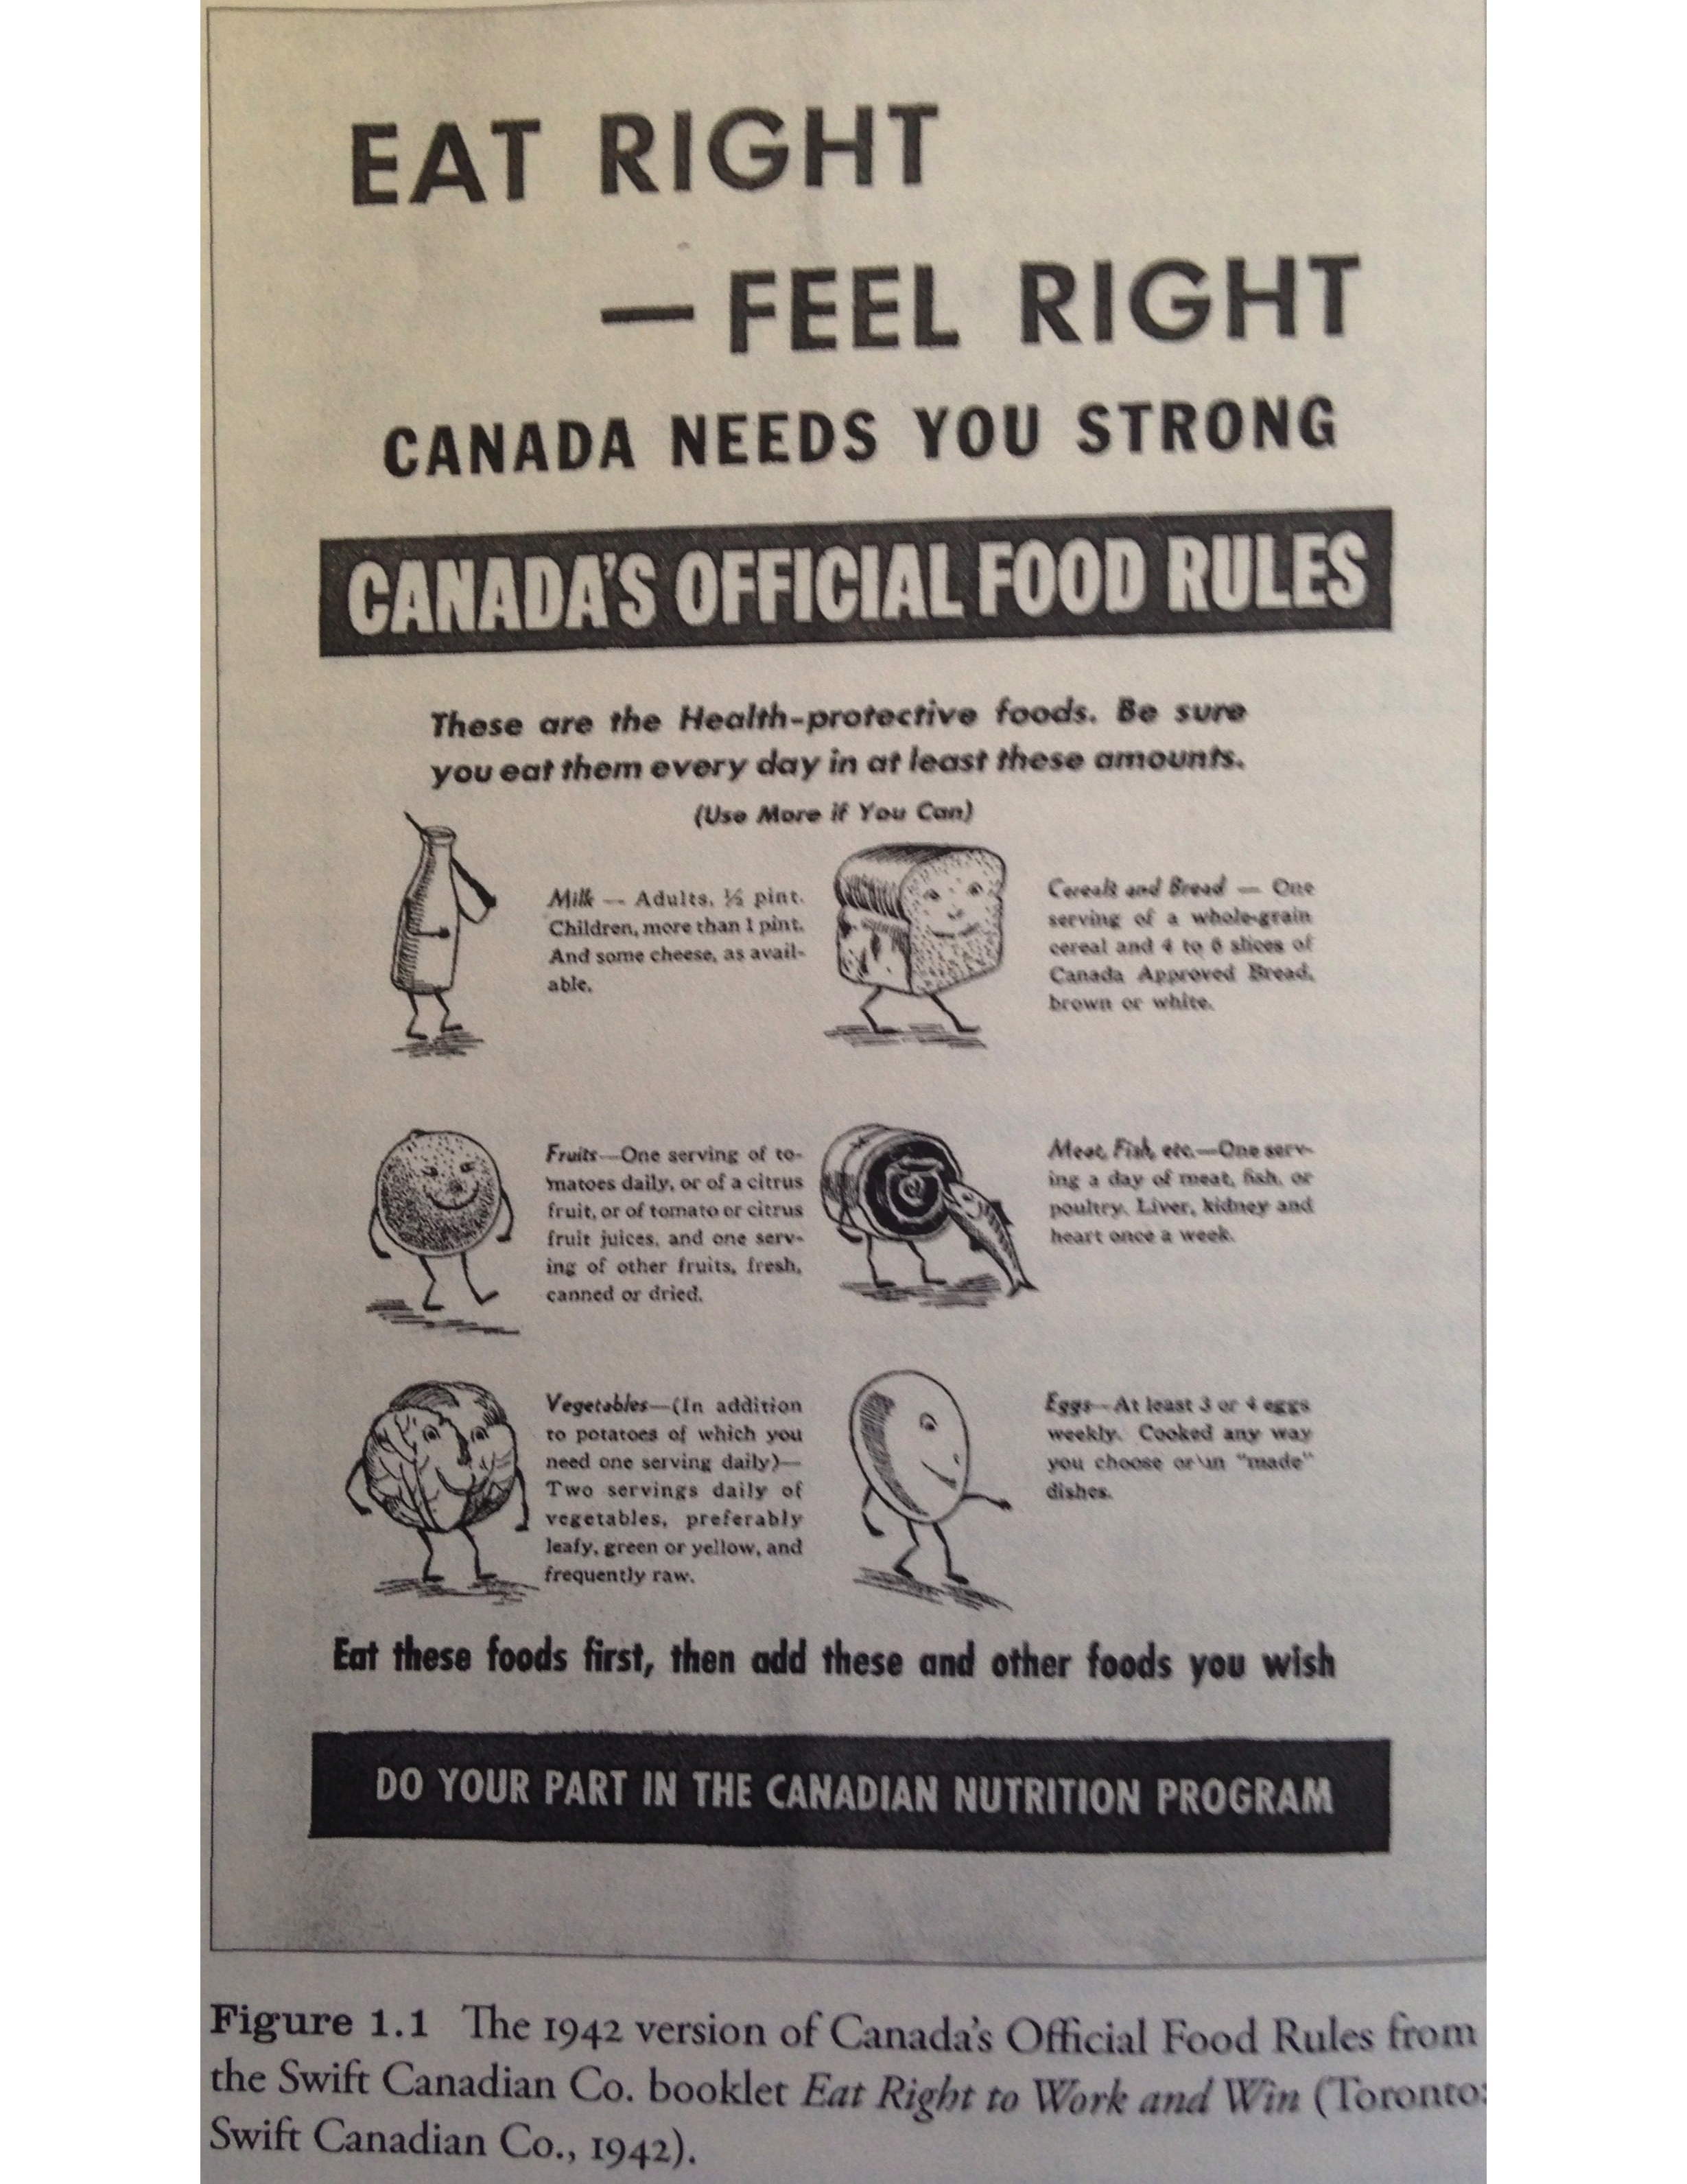
Canada’s Official Food Rules, 1942

Slide 3
II. Nutrition
What are the basic food needs of humans?
Essential nutrients: those that the body cannot synthesize itself and so must come from food
Four categories of essential nutrients
  Sources of energy (carbohydrates, fat, protein, alcohol)
  Essential amino acids, fatty acids, vitamins, minerals, and trace elements
  Fibre
  Water

Slide 4
III. Culinary Systems
How have humans created culinary systems to meet their food needs?
Preservation of Foods
  Refrigeration
  Drying
  Brining (soaking in brine)
  Heating
  Salting
  Smoking

Slide 5
III. Culinary Systems
Culinary Systems
  Methods for producing, preparing, consuming, and attaching meaning to food
Four Major Processes in the Creation of Culinary Systems
  Creation of methods of subsistence
    hunting & gathering
    agriculture
  Diffussion of food and subsistence methods
  Role of social identities (class, gender, ethnicity)
  Role of the state (government)

Slide 6
IV. Major Concepts
What are the major concepts we will use in this course?
Foodways: “ways of conceptualizing, evaluating, preparing and consuming foods characteristic of a particular society, cultural group or geographical area” (Dic Human Geog)
Culinary Systems: the systems (environmental, political, economic, cultural) by which societies produce, prepare, consume and attach meaning to food.

Slide 7
IV. Major Concepts
Food Security: “food security exists when all people, at all times, have physical and economic access to sufficient, safe and nutritious food that meets their dietary needs and food preferences for an active and healthy life” (Food & Agriculture Organization, as revised at the World Food Summit, 1996. Source: “Food Security.” FAO Policy Brief, June 2006, Issue 2. Web.

Slide 8
Iv. Major Concepts
Food Sovereignty: “Food Sovereignty is the right of peoples to healthy and culturally appropriate food produced through ecologically sound and sustainable methods, and their right to define their own food and agriculture systems” (La Via Campesina).

