Slide 1
Taste
Introduction: Turtle Soup
The Biology of Taste
How are Tastes Formed?
Things to Consider When Preparing your Cooking Class Assignment

Slide 2
Turtle Soup

Slide 3
Turtle Soup

Slide 4
II. The Biology of Taste
How does the human body process taste?
Taste buds
On surface of the tonque
On papillae (small bumps on the tongue)
Contain: receptors
Four or five tastes: sour, salty, sweet and bitter, and umami
Saliva
Tastant
Sodium ion (Na+) enters receptor via sodium channel

Slide 5
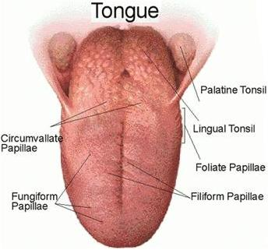
The Tongue

Slide 6
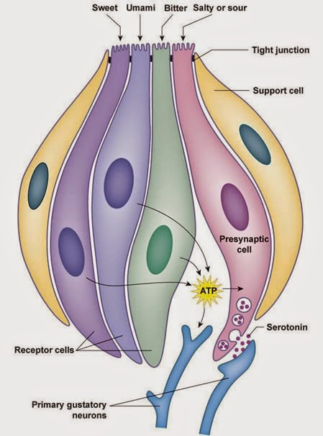

Slide 7
II. The Biology of Taste
Flavour
Retronasal olfaction
Texture
Spiciness = irritation
Food preferences = combo of genetics and experience

Slide 8
II. The Biology of Taste
Sum
Taste happens when saliva breaks down food into simple chemicals which react with receptors in your taste buds
Five tastes (name them) that correspond to different chemical processes in your taste buds – salty taste when Na+ ions enter “sodium channels”
Flavour is taste + smell, and also texture + anticipation/appearance
People are born appreciating certain tastes, but learn to appreciate flavours

Slide 9
III. How are Tastes Formed?
What are the factors that shape tastes, that determine what a given culture finds good to eat?

Slide 10
Availability
Basic diet of agricultural societies
Single complex carb (rice, corn tortillas, wheaten bread, noodles)
PLUS
Supplement
Often “sundried, fermented, cured, smoked, salted, semiputrified”)
Grasses, fungi, dried spices, fruit

Slide 11
Use
Functionalism
Marvin Harris

Slide 12
Culture
Cultural Anthropology
Claude Levis-Strauss – “good to think with”
Mary Douglas
Leviticus 11:1: “Any animal that has divided hoofs and is cleft-footed and chews the cud—such you may eat.”

Slide 13
Power
Ad for infant forumula, likely early 20th century

Slide 14
The Soda Jerk (1953) Norman Rockwell

Slide 15
V. Things to Consider When Preparing your Cooking Class Assignment
Biology
Availability
How available were these ingredients? Why were they available? What historical process led to their availability?
Use
What sort of useful social function might this dish serve (tea; fast food) or how did it rest on a material reality?
Culture
What did this dish mean to people? How did it come to give meaning to a group or activity?
Power
How does this dish emerge as a result of economic or political power? How does it reinforce that power?

