Slide 1
The Columbian Exchange
Introduction
America and the New Global Culinary System

Slide 2
Learning Goals
By the end of this section of the course, you should understand:
The origins of the culinary system that made tea ”taste good”
Specifically, you should understand
The importance of European colonization and commerce to this system
What ”The Columbian Exchange” was and why it was important
The role of sugar, coffee, and tea in this system (and how they were produced, prepared and consumed)
How and why new food traditions were created and with what effects

Slide 3
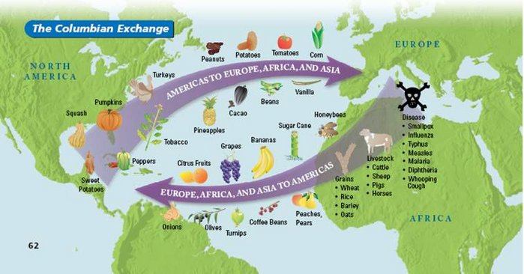
The Columbian Exchange

Slide 4
II. America in the New Global culinary System
What were the implications of the Columbian Exchange for the Americas?
Hernan Cortes in Aztec capital of Tenochtitlan, 1519
Famine in Tenochtitlan, 1454
Moctezuma the Elder
Colmenero de Ledesma

Slide 5
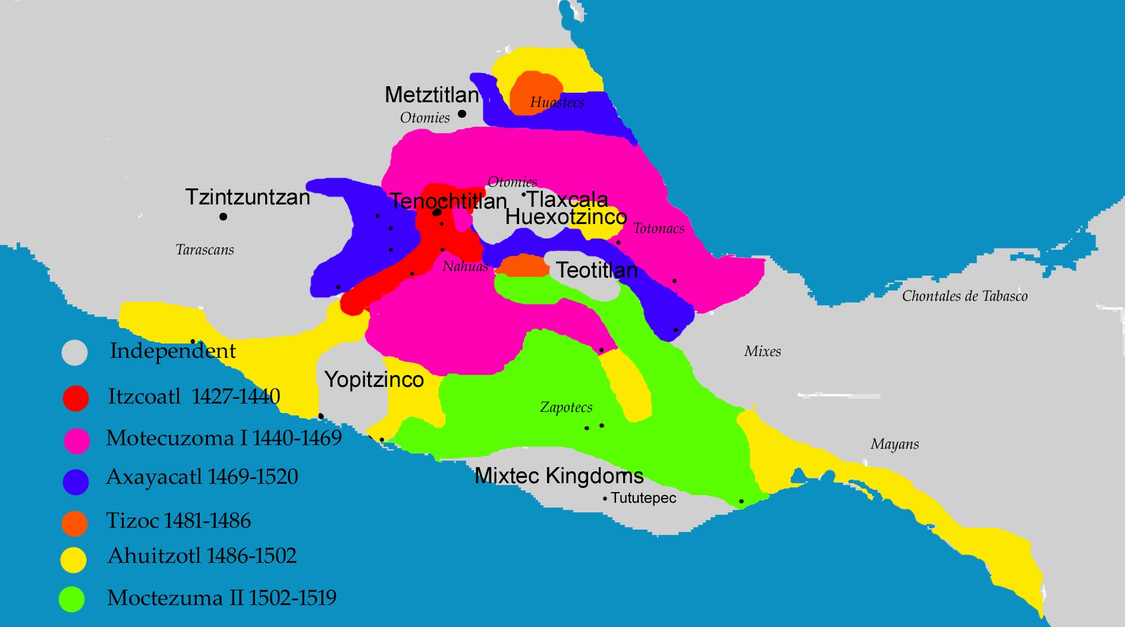
The Aztec Empire

Slide 6
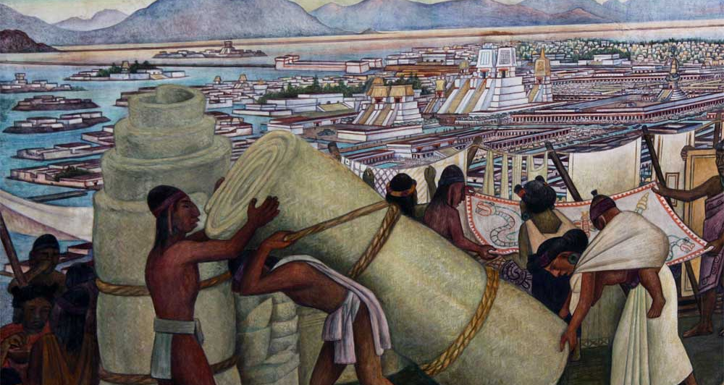
The Grand tenochtitlan (detail) by Diego Rivera

Slide 7
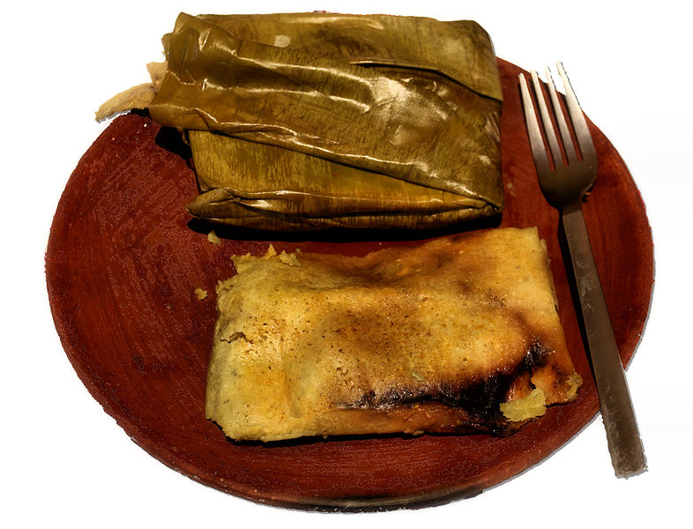
Tamale Oaxaquenos

Slide 8
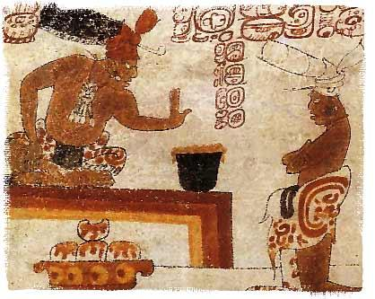
A Mayan Lord Forbids an Individual from Touching a Container of Chocolate

Slide 9
Old World to the New
Dysentery Bubonic Plague
Chicken Pox Cholera
Diphtheria Measles
Influenza Jaundice
Malaria Meningitis
Mumps Small Pox
Tonsillitis Trachoma
Typhus Whooping Cough

Slide 10
New World to the Old
Syphilis
The Syphilitic, 1496

Slide 11
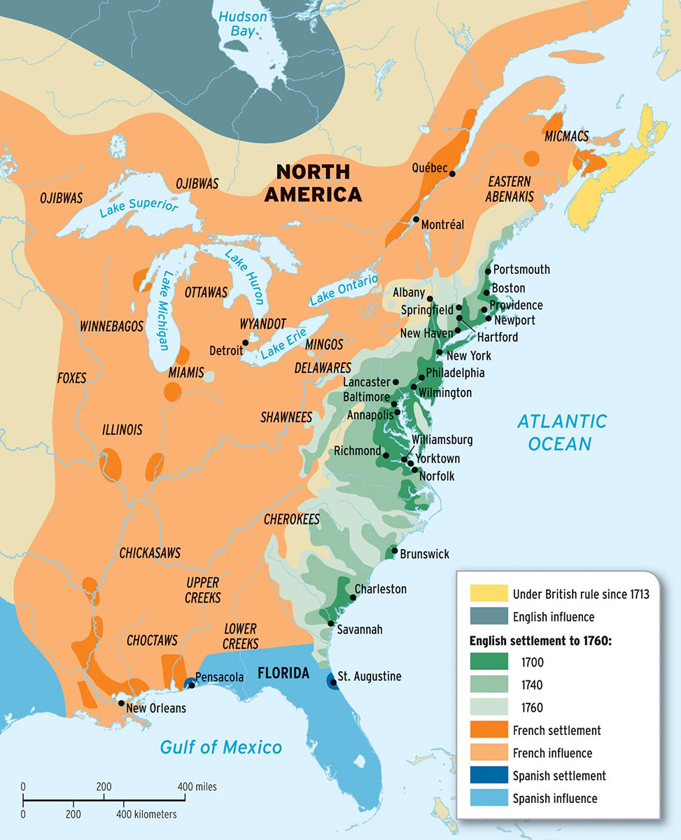
Eastern North America North of Mexico, 1760

Slide 12
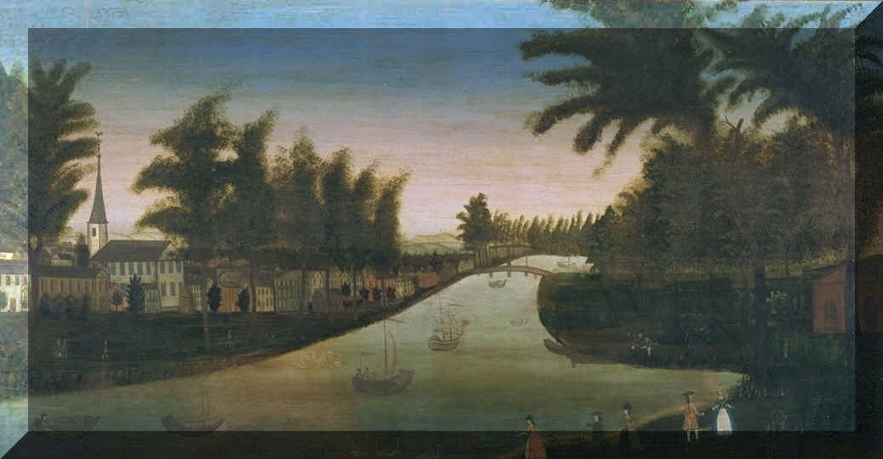
Colonial Landscape

