Slide 1
Food & Industrialization
Introduction
Food & Industry
Preparation
Consumption

Slide 2
Learning Goals
By the end of this section of the course, you should understand:
The origins of the culinary system that made chop suey and pizza ”taste good”
Specifically, you should understand
  What the industrial revolution was and why it happened
  How and why industrialization produced more standardized, pre-produced foods shipped over long distances and the drawbacks of this food
  How national and ethnic food developed
  How the French pioneered the idea of national food and fine cuisine

Slide 3
II. Food & Industry
How did the industrialization revolution lead to new ways of producing, preparing and consuming food?

Slide 4
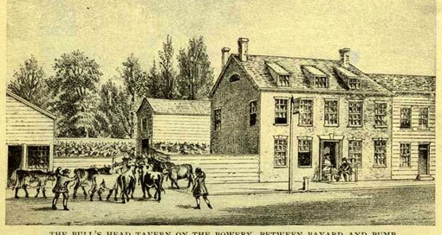
Bulls Head Tavern, New York

Slide 5
III. Preparation
How did industrialization lead to new ways of preparing food?
Refrigeration
Canning
  Nicolas Appert, 1809
  In US shops by 1830s
Disassembly Line, Cincinnati
Grain Elevator, 1842
Chicago dominates grain trade, late 1850s
Winnipeg, late 19th century
Hungarian roller mills
Smooth Dutch chocolate, 1828

Slide 6
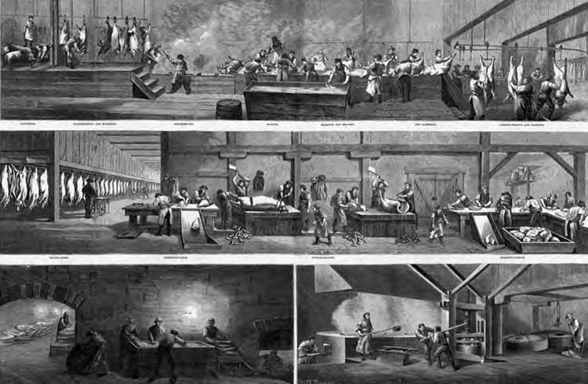
Disassembly Line, Cincinnati, 1873

Slide 7
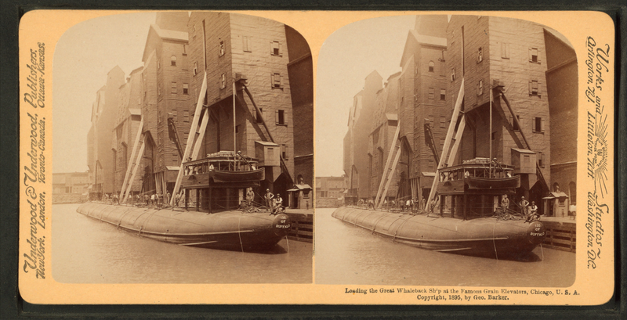
Stereo Image of Grain Elevators, Chicago, 1895

Slide 8
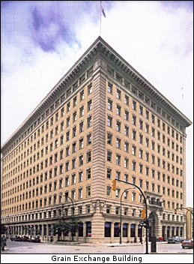
Winnipeg Grain Exchange Building (1908)

Slide 9
IV. Consumption
How did industrialization change how people got their food and what foods they ate?
Iceberg lettuce, 1903
Wonder Bread, 1920
Kellog Develops Corn Flakes, 1900
Oleomargarine, 1866
Law prohibiting adulteration of food, Canada, 1905
The Jungle by Upton Sinclair, 1906

Slide 10
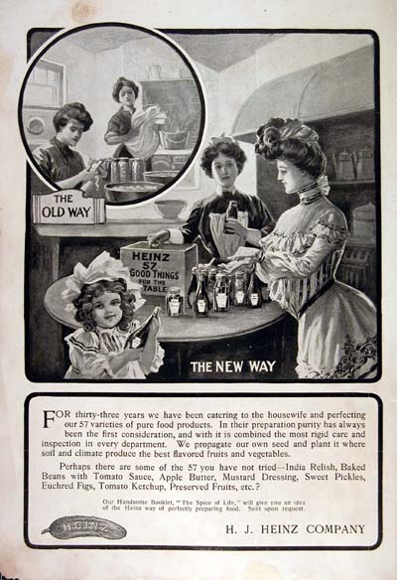
Heinz Ad

Slide 11
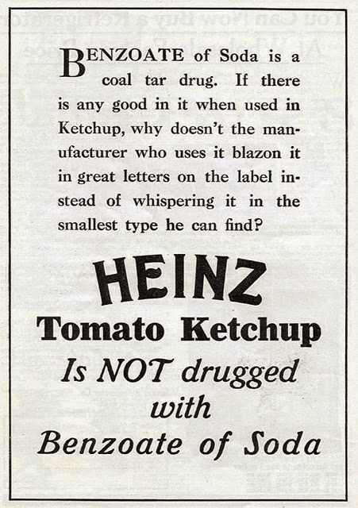
Heinz Ad Addresses Fears of Impurities, 1909

