Slide 1
New Ontario
Introduction
New Ontario
The Culinary System of New Ontario

Slide 2
Learning Goals: Finnish Pancakes (Working-Class Food)
The origins of the culinary system that made Finnish pancakes taste good
Specifically, you should understand:
  Who the indigenous people of northern Ontario were, the major treaties in northern Ontario, and where settlers came from
  The role of resource extraction in shaping northern Ontario before World War II
  How people produced, prepared and consumed food in northern Ontario before World War II
  Who the Finns are, why they came to northern Ontario, what they did here, and why many of them were politically radical
  What is meant by working-class culture, how it formed, and what food had to do with it

Slide 3
New Ontario
How was northern Ontario resettled? How was New Ontario created?
Robinson-Superior and Robinson-Huron Treaties
  Chief Peu de Chat (“Cat Pelt”) and Lake Superior Chiefs sign on Sept 7, 1850
  Shinguacouse and Lake Huron leaders (including Nipissing FN) sign on Sept 9
Ottawa and Opeongo Road
  200 lots occupied by 1859
  Being abandoned by 1865

Slide 4
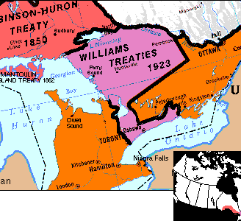
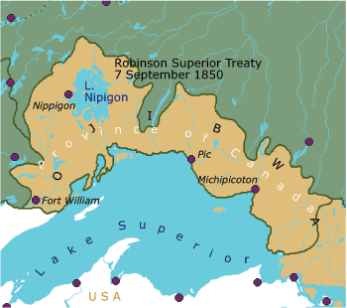
Robinson Treaties
Robinson-Huron & Williams Treaties
Robinson-Superior Treaty

Slide 5
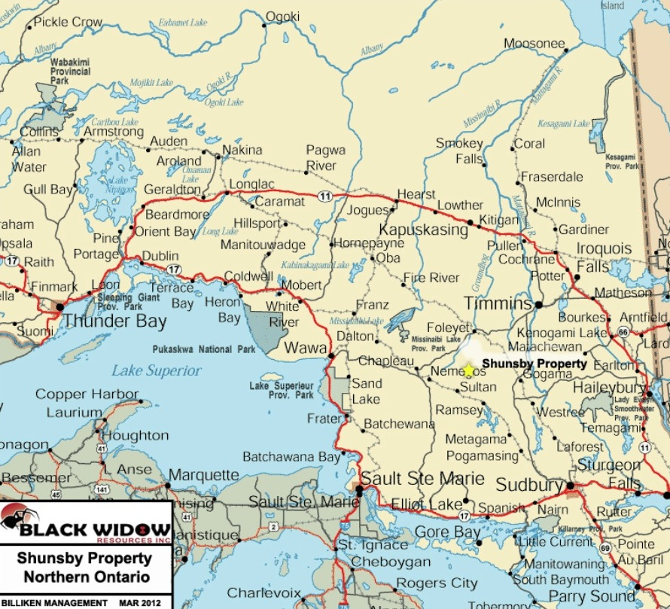
Northern Ontario

Slide 6
New Ontario
Mowat government and northern development (1872-1896)
  25,000 people on 1.2 million hectares of land
  Over 7,000 km of colonization roads
  57,400 acres of farmland in Northwestern Ontario, 1891 – ¾ pastureland or woodlots
  Mineral and timber rights supply 1/3 of ON gov’t revenue
Little Clay Belt
  11,911 farms covering 2 million acres in 1931
Temiskaming and Northern Ontario Railway, 1902

Slide 7
New Ontario
Abitibi Pulp & Paper at Iroquois Falls one of world’s largest, late 1920s
Thunder Bay world’s largest grain port, 1920s
Finns in Canada
  15,497 in Canada, 1911
  8,619 in northern ON, 1911 (56% of national population)
  Finnish Civil War, 1918
  Oskari Tokoi
  Socialist newspaper Vapaus (Freedom), Sudbury, 1917
  Immigration stopped in 1930
  41,683 in Canada, 1941 (64% in northern ON)

Slide 8
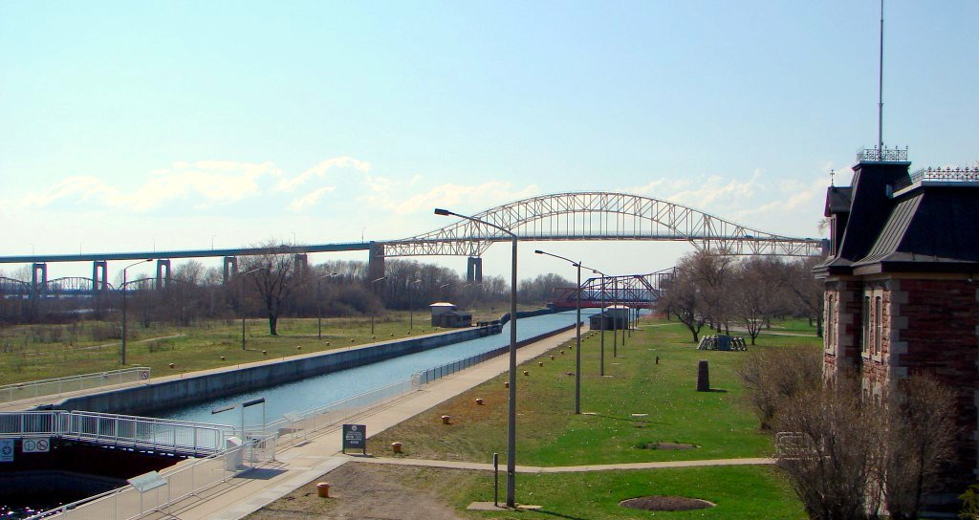
Sault Locks, Sault Ste Marie

Slide 9
III. The Culinary System of Northern Ontario
How did people produce, prepare and consume food in northern ON?
Small scale farms mixing subsistence farming with sale of crops and work off farm
“seasonal round”
chiard” (minced meat and potatoes) with grilled salt bacon (“grillades de lards salés”
Feeding a small logging camp
  36 barrels of pork, 10 barrels of beef, 34 barrels of flour, 76 bushels of potatoes, 20 tons of hay, 400 bags of oats
Cundari family, North Bay

