Slide 1
Food, Solidarity, and Working-Class Resistance
Introduction
The Working-Class and Working-Class Resistance
Food & the Formation of Working-Class Culture

Slide 2
II. The Working-Class and Working-Class Resistance
What is the working-class culture? How did it emerge? What forms did working-class resistance take?
Toronto Printer’s Strike, March-April 1872
Trade Union Act, 1872
9 Hours Movement, 1872
Canadian Labour Union, 1873
Trades & Labour Congress of Canada, 1883
Panic of 1873
89 of 394 railroads in US go bankrupt
14% unemployment
45% pay cuts

Slide 3
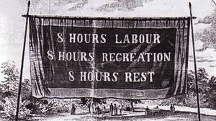
Workers Demand an Eight Hour Day

Slide 4
II. The Working-Class and Working-Class Resistance
Great Railroad Strike, 1877
Knights of Labor
Founded 1869 in Philadelphia
28,000 members, 1880
100,000 members, 884
20% of all US workers members, 1886
Haymarket explosion, 1886
Springhill Miners’ Strike, 1909-1911
Gold Miners’ Strike, South Porcupine, 1912-13
International Workers of the World (“Wobblies”)

Slide 5
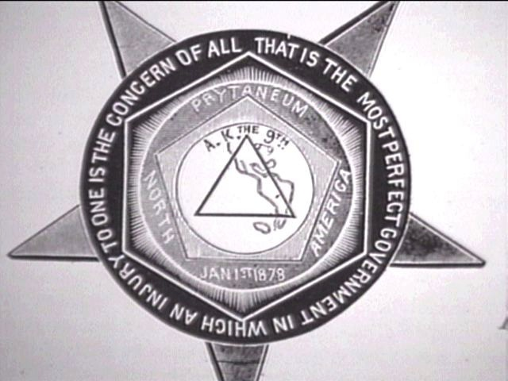
The Seal of the Knights of Labor

Slide 6
II. The Working-Class and Working-Class Resistance
Finnish organizations in northern Ontario
Temperance society, Sault Ste Marie, 1893
Temperance society, Copper Cliff, 1893
Socialist Organization and community hall, Thunder Bay, 1903
Tyokansa (Working People), newspaper, 1907
“Big Finn Hall,” Thunder Bay, 1911
Finnish Socialist Organization of Canada, 1911
Loggers’ strike, Lumber Workers Industrial Union of Canada, Sept, 1926

Slide 7
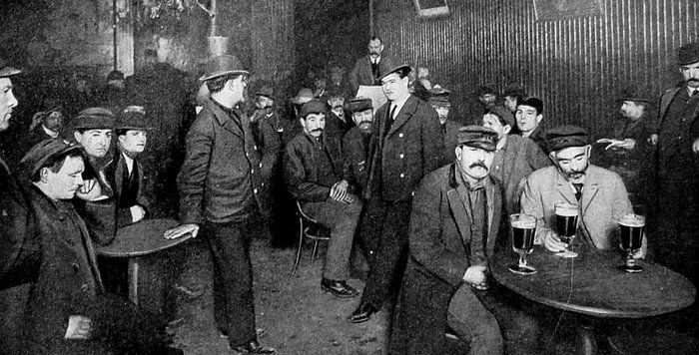
III. Food & the Formation of Working-Class Culture
How did food help to form working-class culture?

