Slide 1
McDonaldization, or the Power of Fast Food
Introduction
Fast Food: Expansion, Taste, Systems
Why Fast Food? Or, Fast Food in its Historical Context
Assessing the Power of Fast Food

Slide 2
II. Fast Food: Expansion, Taste, Systems
What are the characteristics of fast food and how did it develop historically?
McDonald’s
First McDonald’s restaurant, 1940
McDonald brothers reform restaurant, 1948
Ray Kroc franchising agent, 1954
1961
300 McDonald’s in 44 states
Ray Kroc buys out McDonald brothers
White Castle, 1920s
Howard Johnson, 1930s

Slide 3
II. Fast Food: Expansion, Taste, Systems
Kentucky Fried Chicken, 1954
Burger King, 1954
Taco Bell, 1962
Expansion to Canada
Dairy Queen, 1953
Kentucky Fried Chicken, 1959
McDonald’s, 1967

Slide 4
II. Fast Food: Expansion, Taste, Systems
Increase in consumption of key fast food ingredients, 1950-2000
Soft drinks: 4 times
Beef: 35%
Chicken: 121%
Cheese: 179%

Slide 5
Ester Reiter on the McDonald’s Task System
“ ‘[The] ketchup is applied by spreading it evenly in a spiral circular motion over the pickles, starting near the outside edge’.” “ ‘[S]even seconds are allotted to placing the fry basket in the fry pot … five seconds to filling the first bag in the bagging cycle, and three seconds to packing each subsequent one’.”

Slide 6
II. Fast Food: Expansion, Taste, Systems
McDonald’s rule book
75 pages,1958
750 pages, mid-1990s
2 million tons of frozen fries, 1998

Slide 7
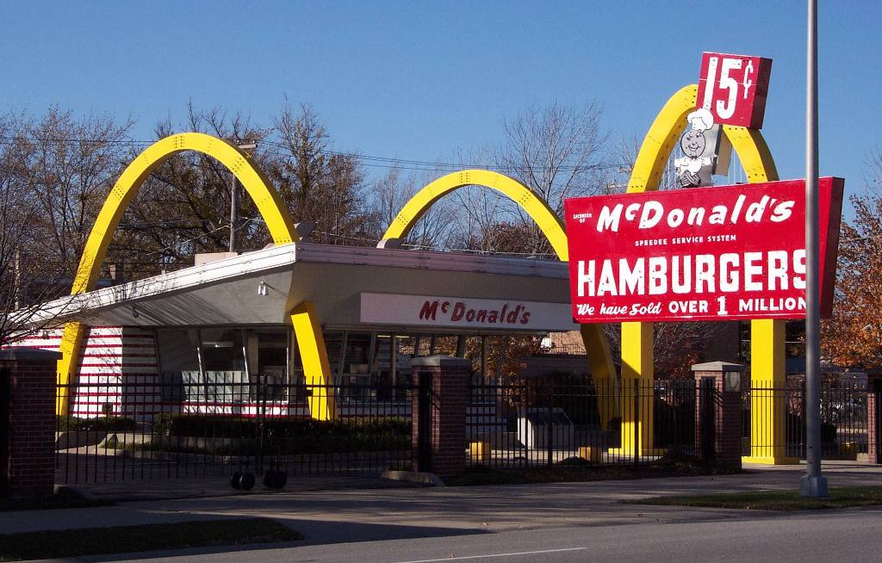
McDonald’s Museum, Des Plaines, Iowa

Slide 8
III. Why Fast Food? Or, Fast Food in its Historical Context
Why did fast food become so huge in the postwar period?
McDonald’s in North America and the World
United States (2015), 14,248
Canada (2105), 1,443
Mexico (2012), 402
Worldwide, over 35,000
On any given day, 1% of the world’s population eats at a McDonald’s

Slide 9
III. Why Fast Food? Or, Fast Food in its Historical Context
7 of the 10 largest fast food chains in the US (1999 figures) were founded sometime between 1948 and 1963
McDonald’s All-American Meal, 1960: costs 45 cents which equals 40 minutes of labour on average
Ronald McDonald, 1963
McDonald’s playgrounds, 1970
“As early as 1973, 97 percent of American children recognized Ronald [McDonald]” (Steve Penfold)
Average wages in US decline after 1973
Early 21st century, 2/3 US mothers of small children work outside the home

Slide 10
IV. Assessing the Power of Fast Food
How powerful is fast food in shaping agricultural systems and foodways? How harmful is it?
Four Major Processes in the Creation of Culinary Systems
Diffusion of foods
Spread of agriculture at the expense of mobile hunter-foragers & pastoralists
Role of social identities (class, gender, ethnicity)
Role of the state

Slide 11
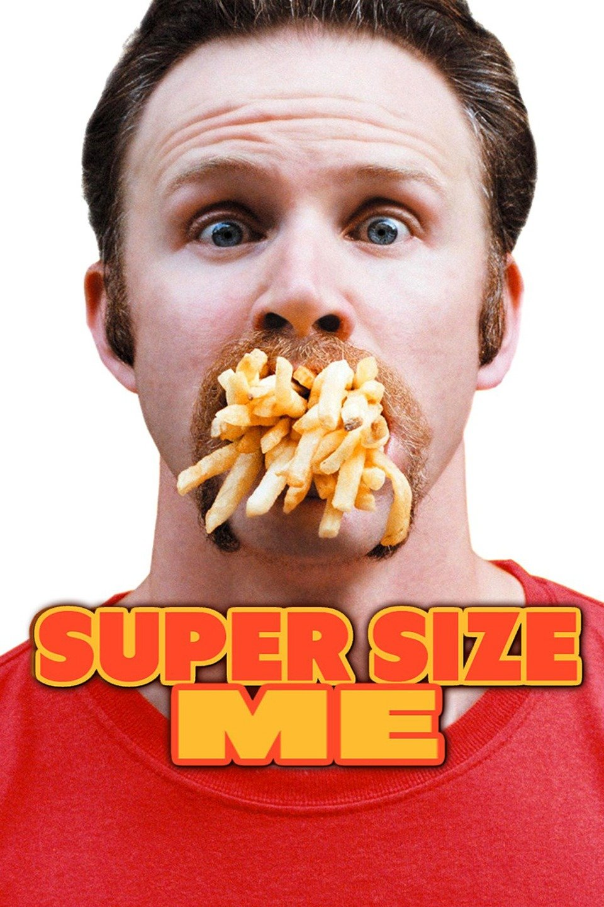
Super Size Me (2004)

