Slide 1
The Food Landscape Today
Introduction
Where Are We Now?
Food Sovereignty in Canada?
What Can History Tell Us About Why we are Here?

Slide 2
II. Where Are We Now?
What are some of the major characteristics and problems of North American (Canadian) culinary systems?
Canadian Food
world’s 4th-largest exporter of food
world’s 4th-largest importer of food
Food Banks Canada report (2010):
10% increase in food bank use since 1999
Alberta, 61% increase in food bank use since 2008
2.5 million Canadians food insecure

Slide 3
II. Where Are We Now?
Food security: food security exists when all people, at all times, have physical and economic access to sufficient, safe and nutritious food that meets their dietary needs and food preferences for an active and healthy life

Slide 4
Problems in the Culinary System
Farms
on-farm revenues less then expenses
Debt, off-farm work
Corporate influence in production and distribution
Aging farmers
biological diversity of the foods being sold in supermarkets is falling
much of the food we eat comes from overseas
carbon footprint
Decline of small and medium-sized farms
Effects of global market on food security
Environmental problems of large commodity-producing farms

Slide 5
Total Number of Agricultural Operations, Canada, 1961 to 2016 Source: Census of Canada, 2016

Slide 6
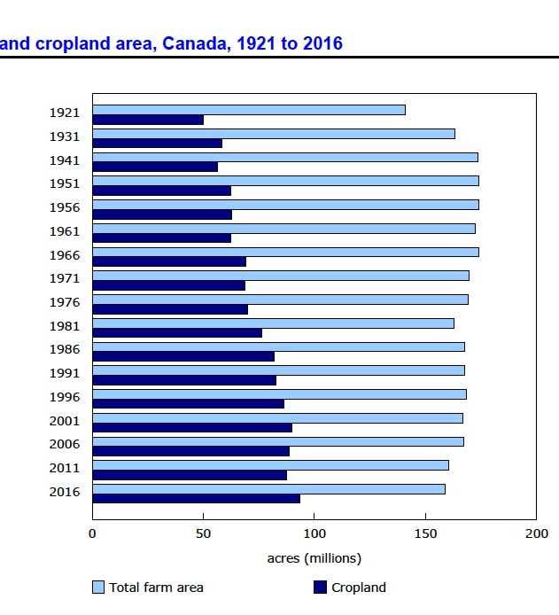
Total Farm Area and Cropland Area, Canada, 1921-2016
Source: Census of Canada, 2016

Slide 7
Proportion of Farm Operators by Age Group, Canada, 2011 to 2016 Source: Census of Canada, 2016

Slide 8
Problems in the Culinary System
Health issues
Food is inexpensive – 12% of family income on average

Slide 9
III. Food Sovereignty in Canada?
How is food sovereignty a response to this situation?
“Food Sovereignty is the right of peoples to healthy and culturally appropriate food produced through ecologically sound and sustainable methods, and their right to define their own food and agriculture systems.”
World Food Conference, Rome, 1974
Community Food Organizations
Nanaimo Food Share
Edmonton Food Policy Council (1988)
Toronto Food Policy Council (1990)
Community food security, end of 1990s

Slide 10
III. Food Sovereignty in Canada?
Food Secure Canada, 2005
Farm Organizations
National Farmers Union and La Via Campesina
Union paysanne
Union des prodecteurs agricoles
Canadian Federation of Agriculture
2,314 local food initiatives in Canada, 2015

Slide 11
III. Food Sovereignty in Canada?
1 in 8 farms in Canada sold directly to consumers
65% of these small-scale operations
chickens, eggs, bees, fruits and vegetables
90% of direct sales of agricultural products was done on the farm or at stands or kiosks

Slide 12
III. What Can History Tell Us About Why We Are Here?
How can the history we’ve been studying help?

